Slide 1
Chapter 12 Torque

Slide 2
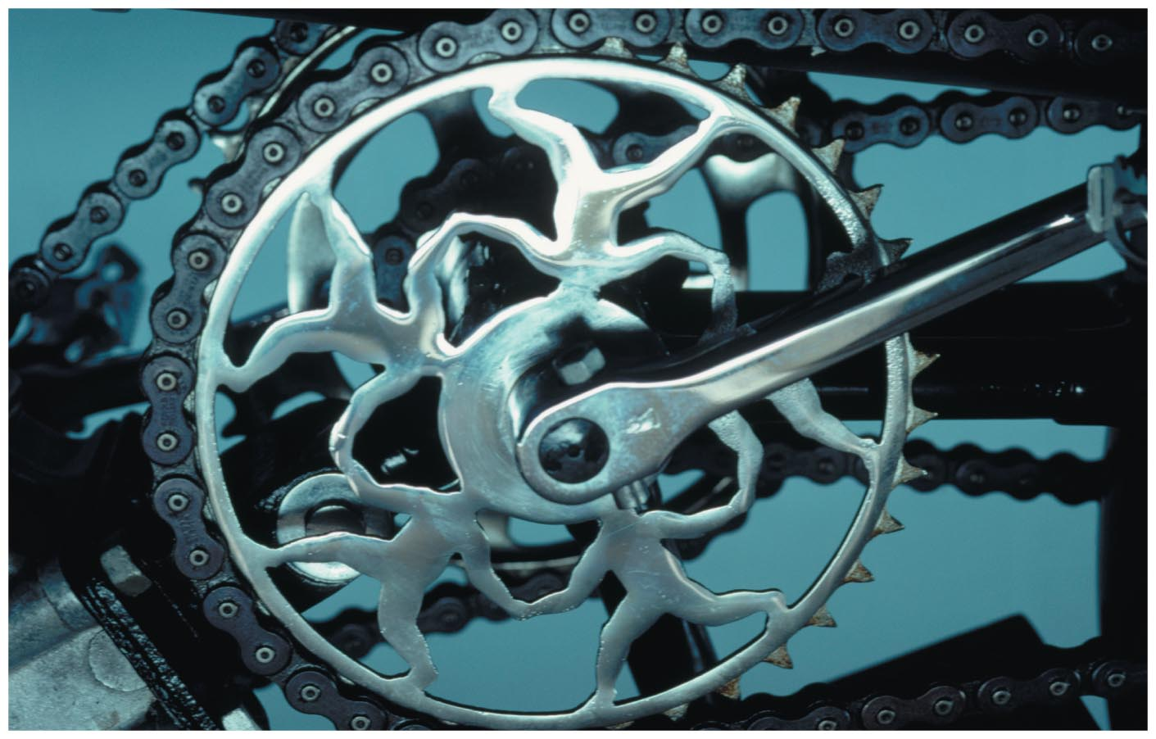
Chapter 12 Torque
Chapter Goal:
To study the causes of the changes in rotational motion using the concepts of torque and angular momentum.
Slide 12-2

Slide 3
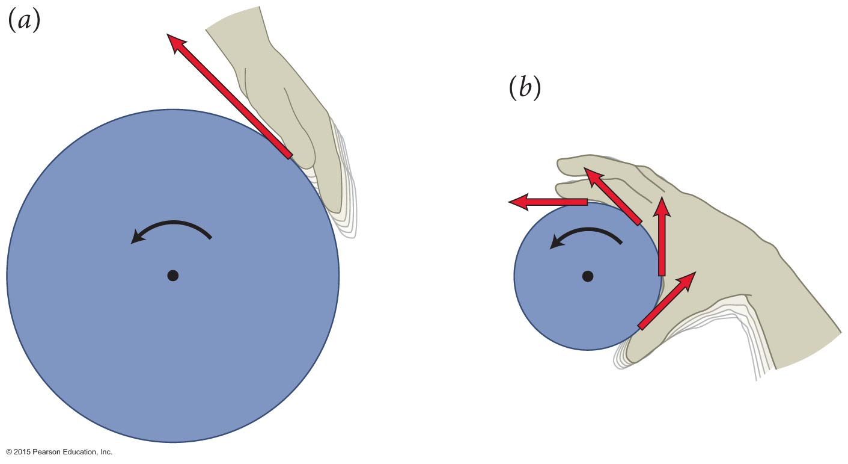
Section 12.1: Torque and angular momentum
If you exert a force on the edge of stationary wheel or a cap of a jar tangential to the rim, it will start to rotate.
Slide 12-3

Slide 4
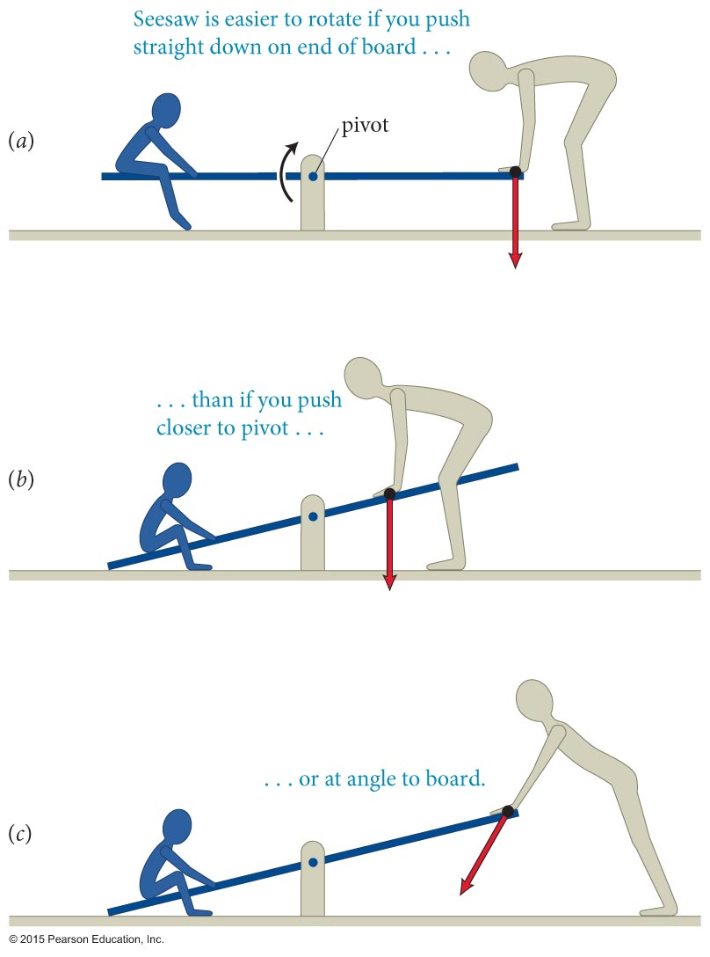
Section 12.1: Torque and angular momentum
To push a seesaw to lift a child seated on the opposite side as shown in the figure with the least force, push
  as far as possible from the pivot, and
  in a direction that is perpendicular to the seesaw.
Why are these the most effective ways to push the seesaw?
Slide 12-4

Slide 5
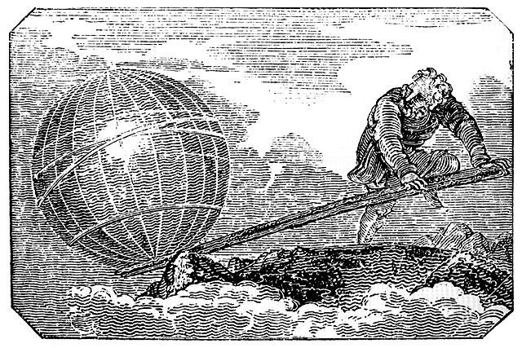
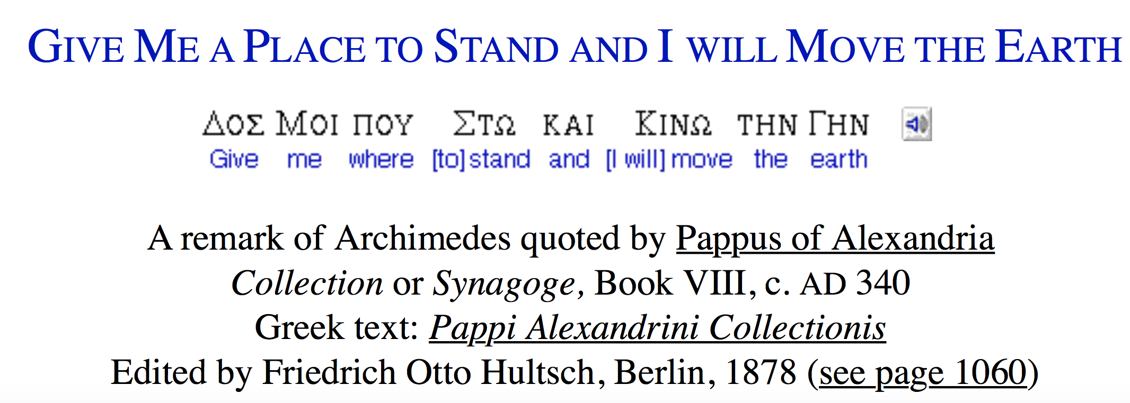

Section 12.1: Torque and angular momentum
https://www.math.nyu.edu/~crorres/Archimedes/Lever/LeverQuotes.html
287 BC – 211 BC
Slide 12-5

Slide 6
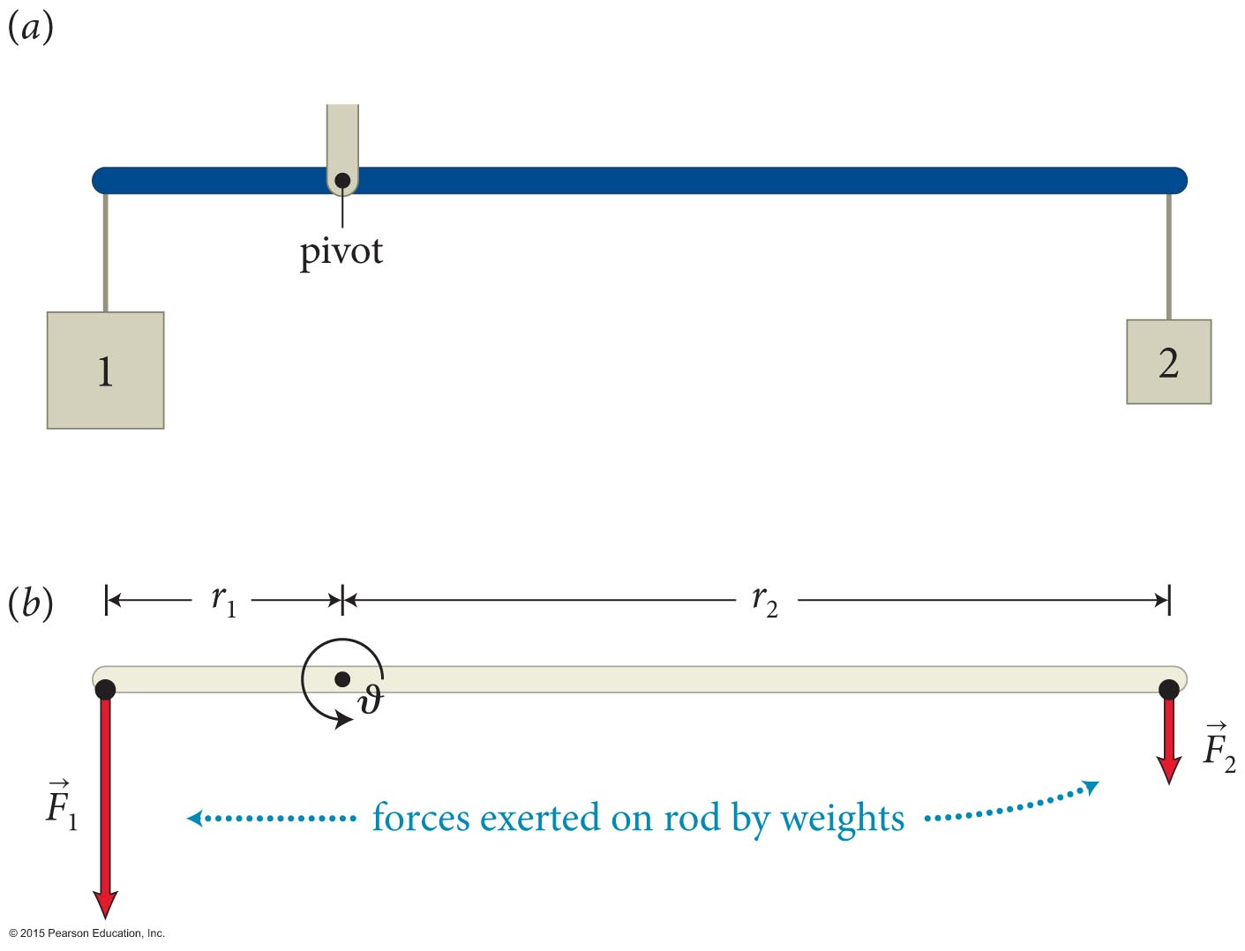
Section 12.1: Torque and angular momentum
The ability of a force to rotate an object about an axis is called torque.
Torque as a result of the principle of virtual work.
Equilibrium is when
This suggests that
torque = r⊥ F,
where r⊥ (referred to as lever arm) is the perpendicular distance from the location of force to the pivot.
Applying the force as far as possible from the pivot point increases the torque.
h₂= θ r₂
r₁
θ
r₂
h₁= θ r₁
Slide 12-6

Slide 7
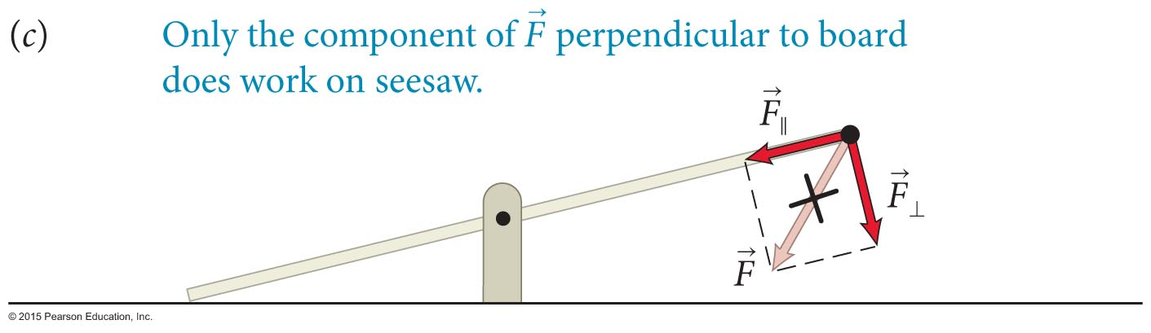
Section 12.1: Torque and angular momentum
A force is most effective at rotating the seesaw when it is oriented perpendicular to the seesaw.
Reason: Only the component of the force perpendicular to the seesaw (F⊥ ) causes the seesaw to rotate.
Slide 12-7

Slide 8
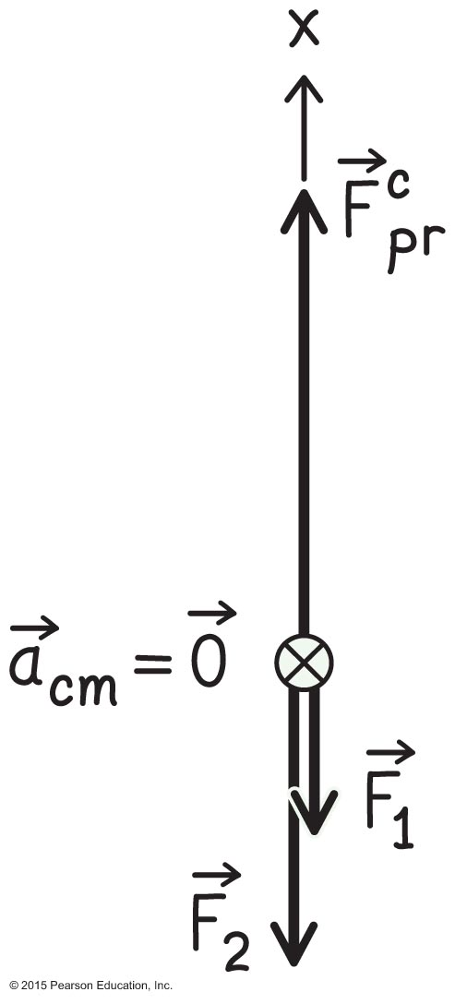
Checkpoint 12.1
(a) Draw a free-body diagram for the rod of the figure below. Let the inertia of the rod be negligible compared to m₁ and m₂.
(b) Would the free-body diagram change if you slide object 2 to the left?
12.1
Slide 12-8

Slide 9
Checkpoint 12.1
(c) When balanced, how is r₁/r₂ related the ratio m₁/m₂?
12.1
Slide 12-9

Slide 10
Checkpoint 12.1 (cont.)
(d) What would happen if you remove object 1?
(e) What would happen if you double the inertia of object 1?
(f) What would happen if you carefully place a penny on top of object 1? Let the inertia of the two objects be significantly larger than that of the penny.
(g) Is there a difference between what would happened in parts e and f ?
12.1
Slide 12-10

Slide 11
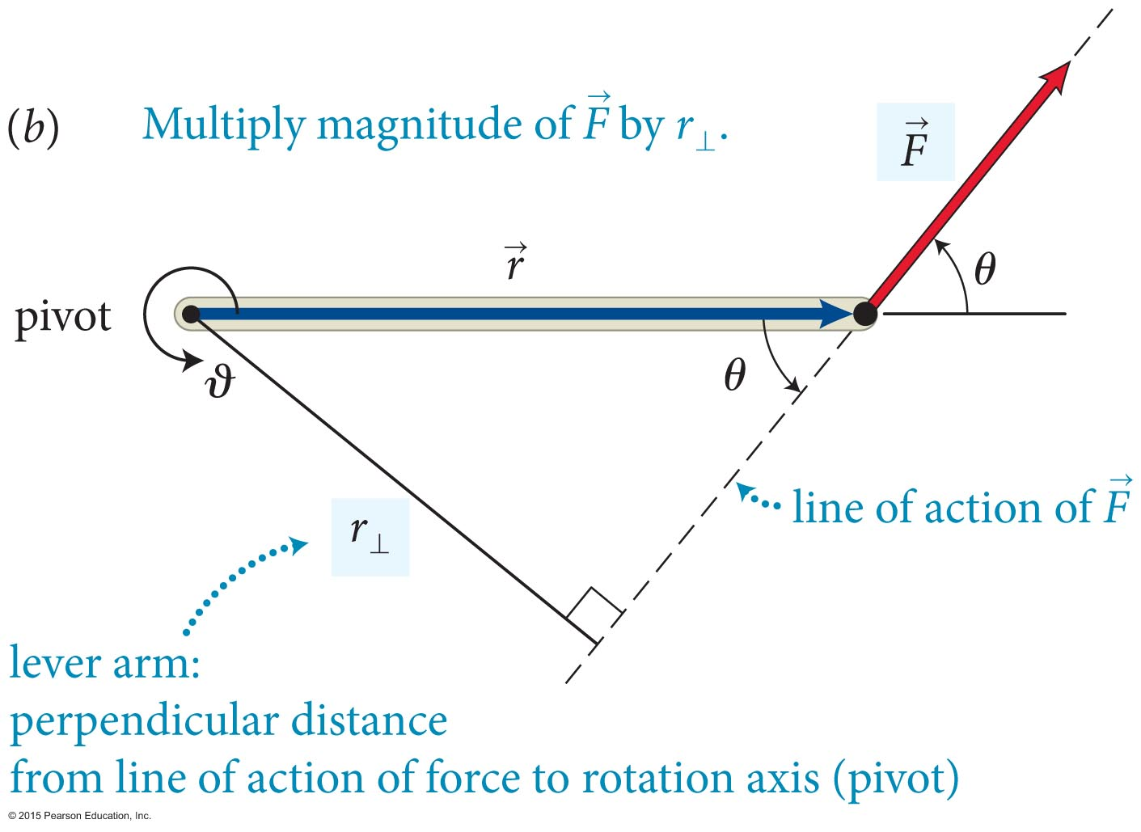
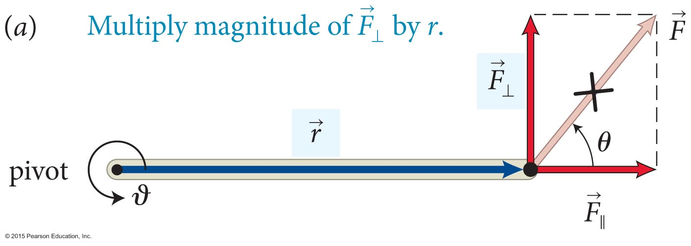
Section 12.1: Torque and angular momentum
Torque is the product of the magnitude of the force and its lever arm distance.
Two ways to determine torque:
torque = rF⊥ = r(F sin θ)
torque = r⊥F = (r sin θ)F
Slide 12-11

Slide 12
Section 12.1: Torque and angular momentum
The mathematical expression for torque is
torque = r(F sinθ)
The effectiveness of a
force to rotate an object
about an axis depends on
  the magnitude of the
  applied force (F).
  the distance from the pivot
  to the point force is applied (r).
  the angle at which the force
  is applied (θ ).
θ
pivot
ϑ
Slide 12-12

Slide 13
Section 12.1: Torque and angular momentum
Torque has a sign.
The sign of the torque depends on the choice of direction for increasing ϑ.
In the figure the torque caused by is positive because it tends to increase ϑ.
The torque caused by is negative.
Therefore, the sum of the two torques is r₁F₁ – r₂F₂.
For stationary objects, the sum of torques is zero.
Slide 12-13

Slide 14
Section 12.1
Clicker Question 2
You are using a wrench and trying to loosen a rusty nut. Which of the arrangements shown is most effective in loosening the nut? Rank from most efficient to least efficient the following arrangements:
Slide 12-14

Slide 15
Section 12.1
Clicker Question 2
You are using a wrench and trying to loosen a rusty nut. Which of the arrangements shown is most effective in loosening the nut? Rank from most efficient to least efficient the following arrangements:
best
2>1=4>3
worst
Slide 12-15
Notes:
Answer: 2>1=4>3. To increase a torque, you can increase either the applied force or the moment arm. Here the force is the same in all four situations, and so this question boils down to comparing moment arms.

Slide 16
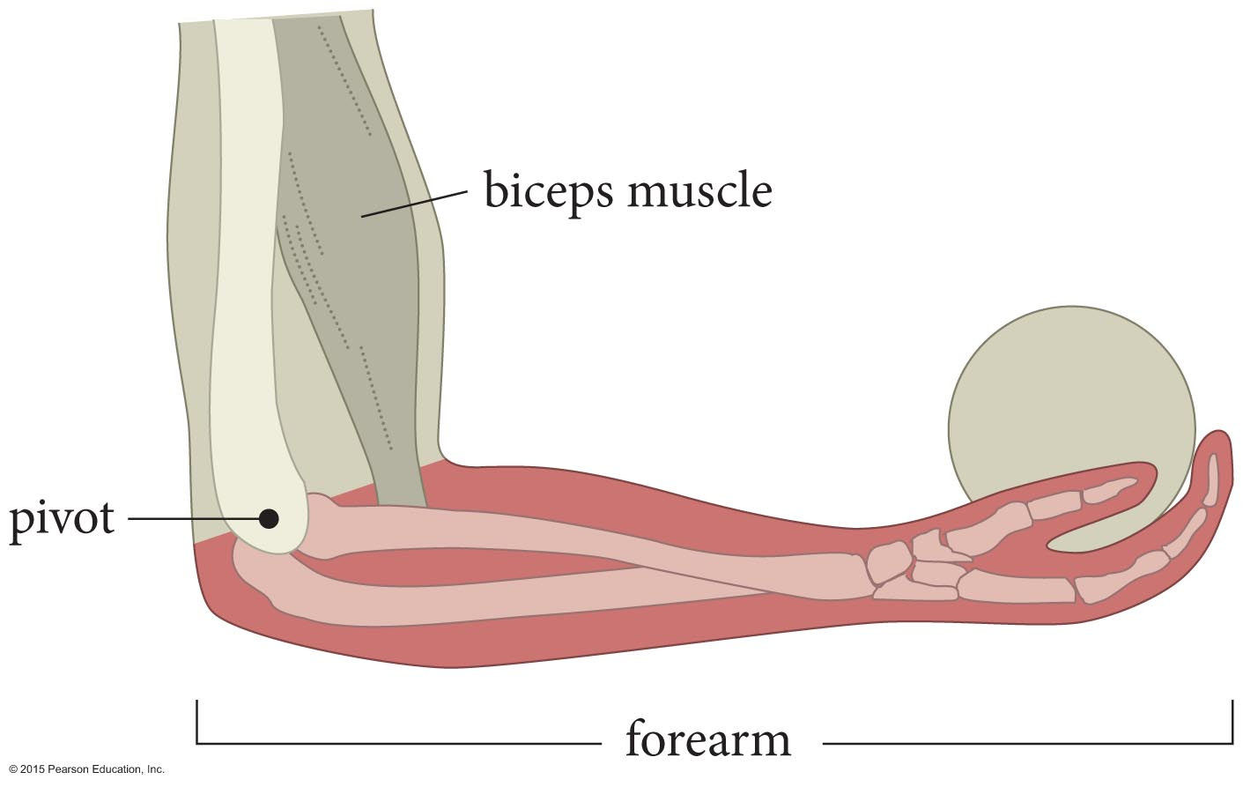
Exercise 12.3 Holding a ball
Section 12.3: Extended free-body diagram
You hold a ball in the palm of your hand, as shown in Figure 12.10. The bones in your forearm act like a horizontal lever pivoted at the elbow. The bones are held up by the biceps muscle, which makes an angle of about 15 with the vertical. Draw an extended free-body diagram for your forearm.
Slide 12-16

Slide 17
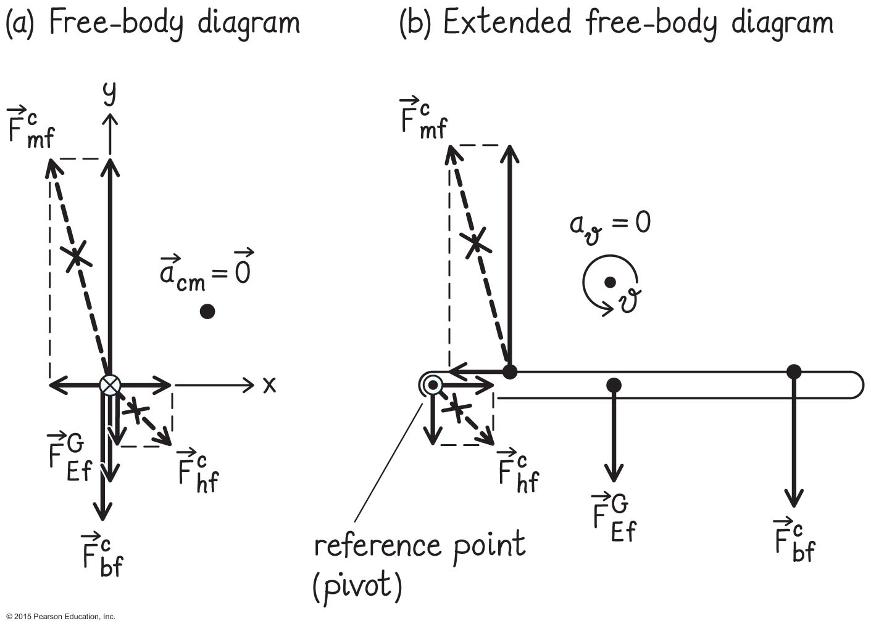
Section 12.3: Extended free-body diagram
Four forces act on forearm; 3 contact, 1 field.
m: muscle
b: ball
h: humerus
f: forearm
E: Earth
applied at CM
Slide 12-17

Slide 18
Exercise 12.3 Holding a ball (cont.)
Section 12.3: Extended free-body diagram
(a) If the biceps muscle in Figure 12.10 were attached farther out toward the wrist, would the torque generated by the muscle about the pivot get greater, get smaller, or stay the same?
torque = r⊥F
Slide 12-18

Slide 19
Exercise 12.3 Holding a ball (cont.)
Section 12.3: Extended free-body diagram
(a) If the biceps muscle in Figure 12.10 were attached farther out toward the wrist, would the torque generated by the muscle about the pivot get greater, get smaller, or stay the same?
torque = r⊥F
Force F the same
r⊥ increases
Slide 12-19

Slide 20
Exercise 12.3 Holding a ball (cont.)
Section 12.3: Extended free-body diagram
(a) If the biceps muscle in Figure 12.10 were attached farther out toward the wrist, would the torque generated by the muscle about the pivot get greater, get smaller, or stay the same?
torque = r⊥F
Force F the same
r⊥ increases
Slide 12-20

Slide 21
Exercise 12.3 Holding a ball (cont.)
Section 12.3: Extended free-body diagram
(b) As the hand is raised above the level of the elbow, so that the forearm makes an angle of 15 with the horizontal, does the arm’s capacity to lift objects increase, decrease, or stay the same?
torque = r⊥F
humerus
Slide 12-21

Slide 22
Exercise 12.3 Holding a ball (cont.)
Section 12.3: Extended free-body diagram
(b) As the hand is raised above the level of the elbow, so that the forearm makes an angle of 15 with the horizontal, does the arm’s capacity to lift objects increase, decrease, or stay the same?
torque = r⊥F
humerus
φ
r⊥
θ
L
Slide 12-22

Slide 23
Exercise 12.3 Holding a ball (cont.)
Section 12.3: Extended free-body diagram
(b) As the hand is raised above the level of the elbow, so that the forearm makes an angle of 15 with the horizontal, does the arm’s capacity to lift objects increase, decrease, or stay the same?
torque = r⊥F
humerus
φ
φ
r⊥
r⊥=L
θ
θ=0
L
Slide 12-23

Slide 24
Chapter 12 Torque

Slide 25
Section 12.3: Extended free-body diagram
How much force do the muscle and bone need to exert to hold the ball?
l = pivot – ball distance
l/5 = pivot – muscle distance
m: muscle
l
b: ball
l/5
h: humerus
E: Earth
f: forearm
Force supplied by the muscle is much greater than the weight of the ball. Why?
Slide 12-25

Slide 26
Section Goals
Section 12.2: Free rotation
Extend the concept of rotation to situations where the axis of rotation of an object is free to move in space.
Understand how the center of mass determines the axis of rotation for unconstrained objects.
Slide 12-26

Slide 27
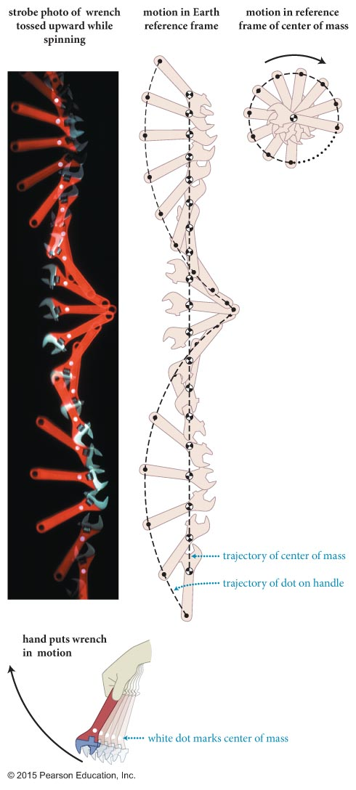
Section 12.2: Free rotation
This figure shows the free rotation of a wrench thrown vertically upward with a clockwise spin.
Notice that the center of mass of the wrench executes a nearly vertical trajectory as it rises.
But notice that the motion of a point near the handle of the wrench is somewhat complicated; it is neither circular nor linear.
Slide 12-27

Slide 28
Section 12.2: Free rotation
Objects that are made to rotate without external constraints always rotate about the center of mass.
Say wrench didn’t rotate about CM, but another point. Then CM would not follow the trajectory of a point particle subject to external forces.
Slide 12-28

Slide 29
Checkpoint 12.4
As the wrench in Figure 12.9 moves upward, the upward translational motion of its center of mass slows down.
Does the rotation about the center of mass also slow down?
Which way does the wrench rotate when it falls back down after reaching its highest position?
12.4
Slide 12-29

Slide 30
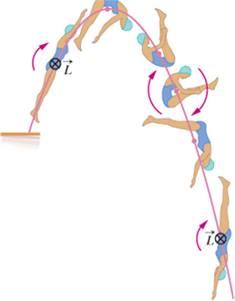
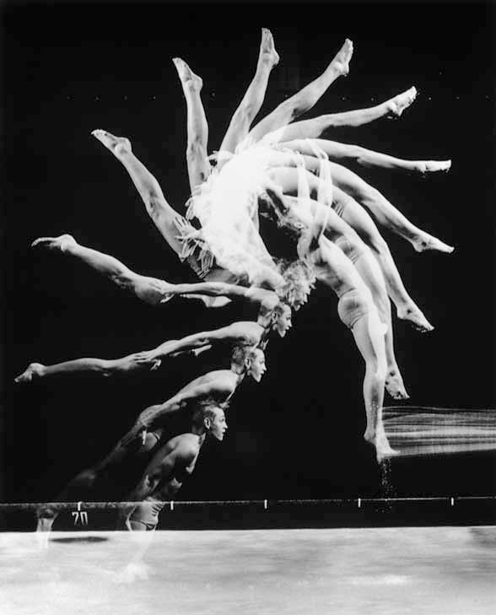
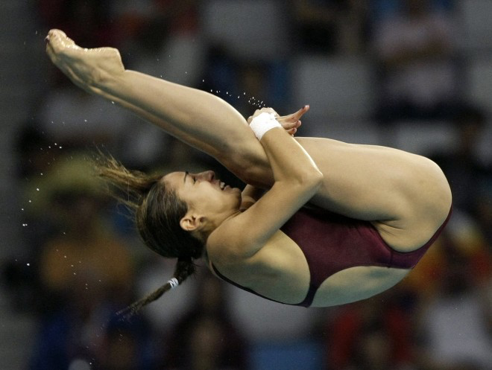
Section 12.2: Free rotation: Rotate about CM
Slide 12-30

Slide 31
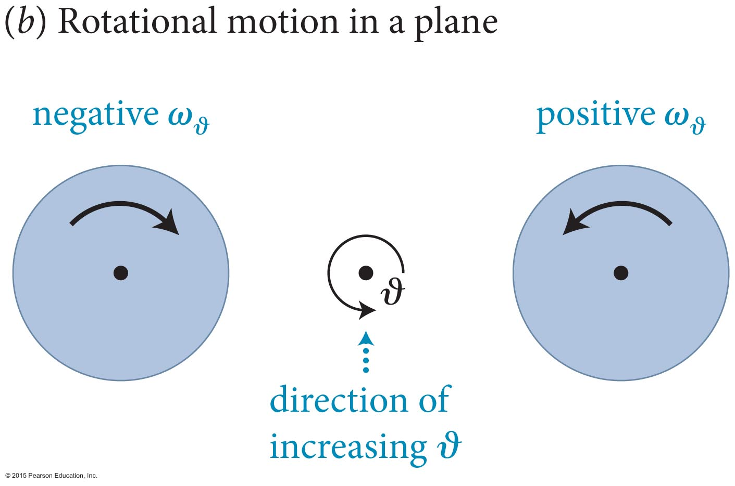
Section 12.4: The vector nature of rotation
The case of rotations that lie in a plane is shown below.
Notice that only an algebraic sign is needed to specify the direction of rotation about the axis of rotation ϑ.
The sign conventions “counterclockwise quantities are positive” and “clockwise quantities are negative” are used.
Slide 12-31

Slide 32
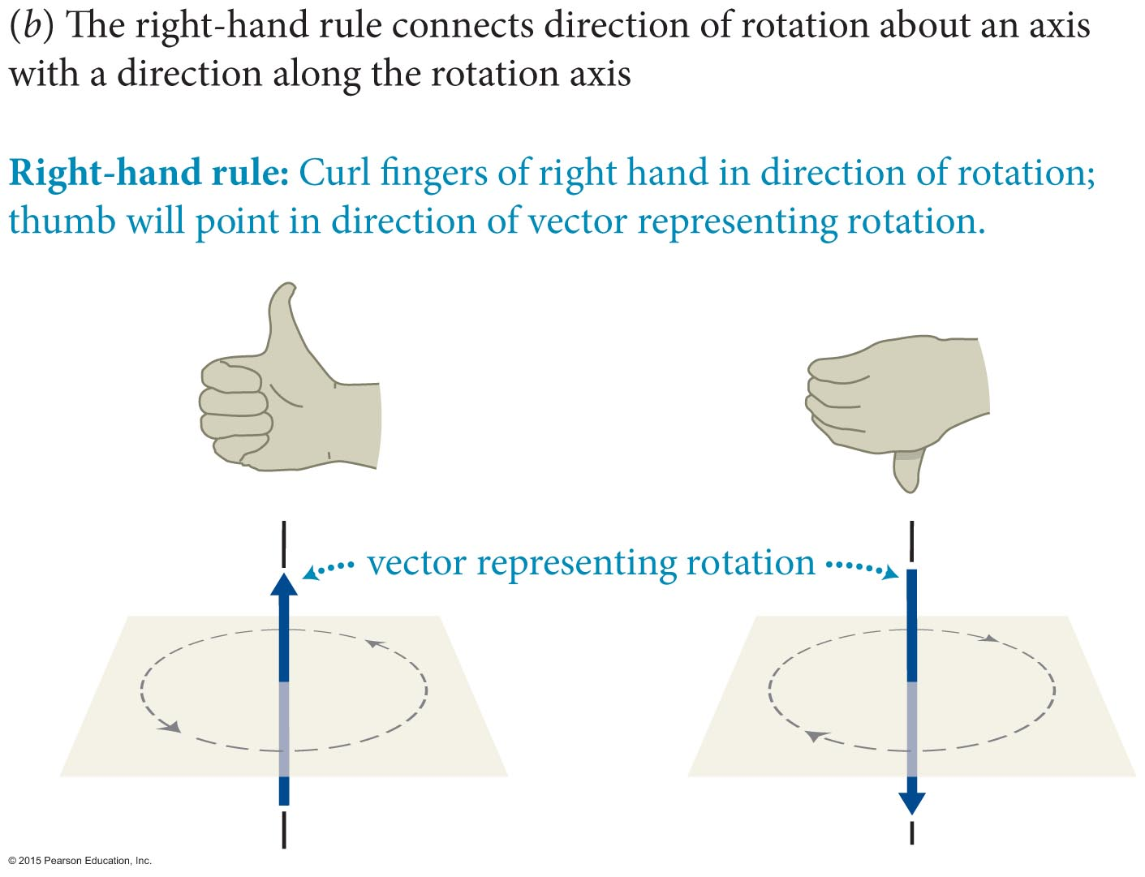
Section 12.4: The vector nature of rotation
The vector description can be determined by using the
right-hand rule:
Notice that if the fingers of the right hand are curled around the rotation, the thumb points in the direction of the vector representing the rotation.
Slide 12-32

Slide 33
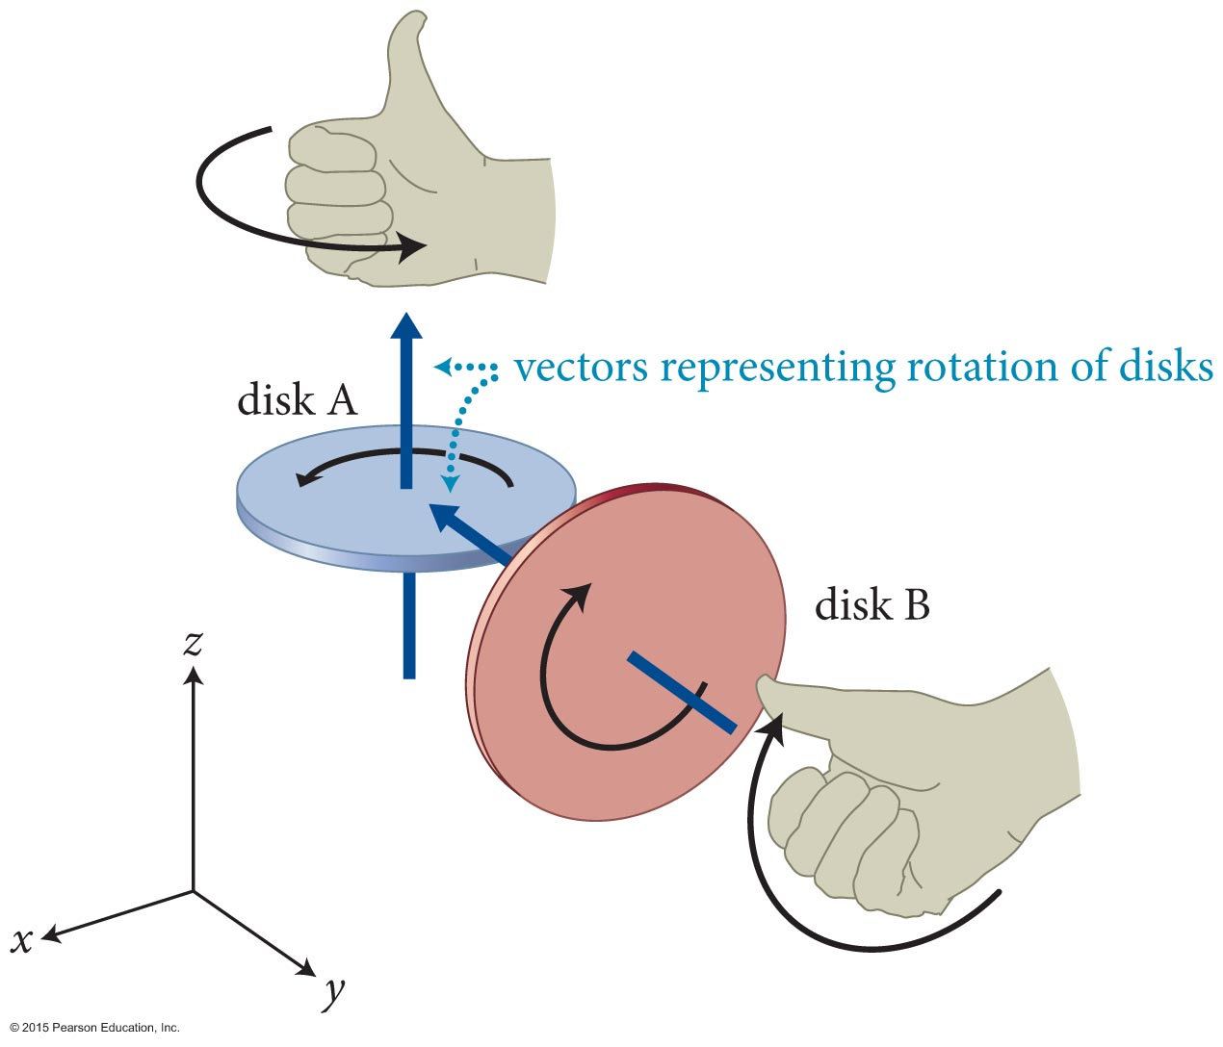
Section 12.4: The vector nature of rotation
The right-hand rule can be used to determine the vector for the rotations of two spinning disks.
Slide 12-33

Slide 34
Section 12.4: The vector nature of rotation
The right-hand rule can be used to determine the vector directions for the rotations of two spinning disks.
The rotation vector for disk A points in the z-direction and has vector components (0, 0, A), where A is a positive number.
The rotation vector for disk B points in the negative y-direction and has components (0, –B, 0) where B is a positive number.
Slide 12-34

Slide 35
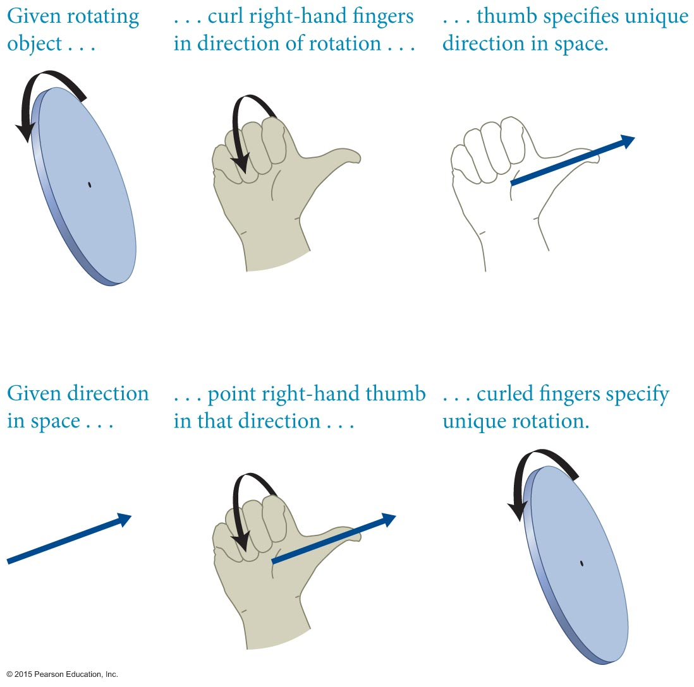
Section 12.4: The vector nature of rotation
The right-hand rule can be used in “reverse” to determine the corresponding rotation for a rotational vector.
Slide 12-35

Slide 36
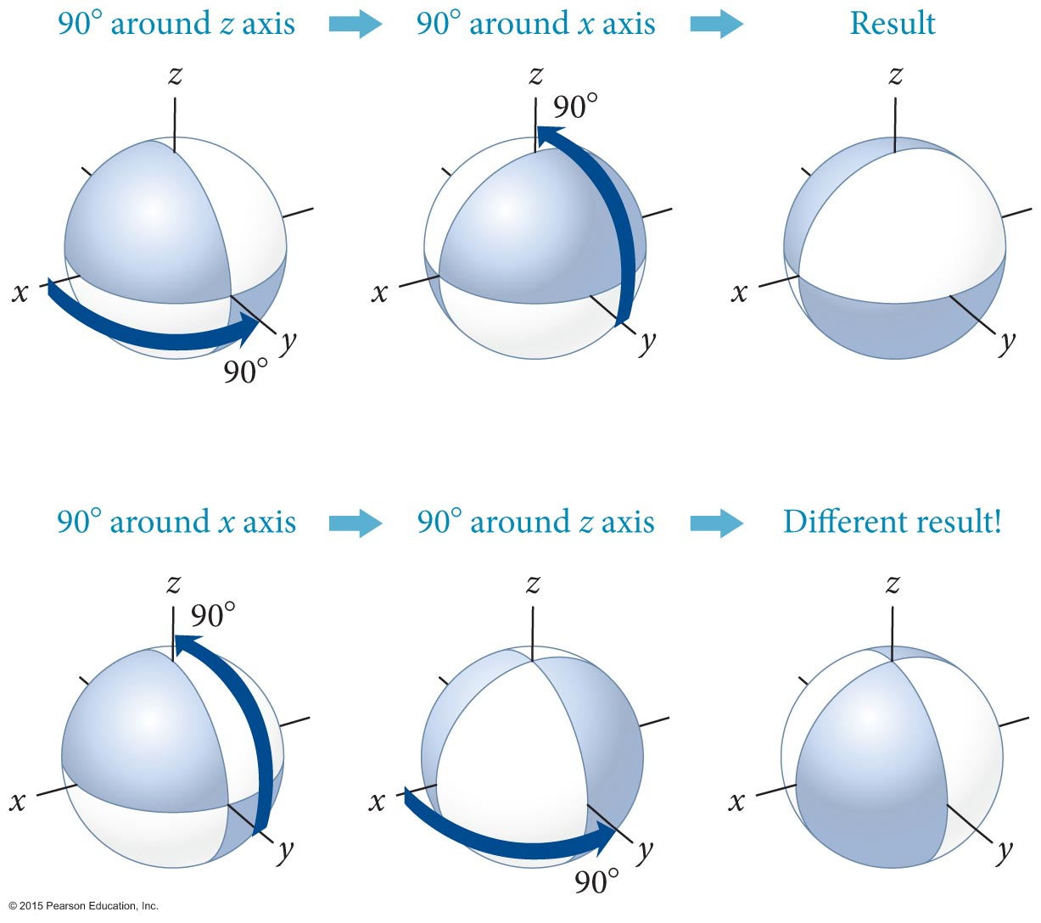
Section 12.4: The vector nature of rotation
Displacement vectors for motion commute. That means that the sum of several displacements is independent of the order added.
Rotational displacements do not commute, however.
See how the orientation of the ball is different depending on the order of rotation!
Slide 12-36

Slide 37


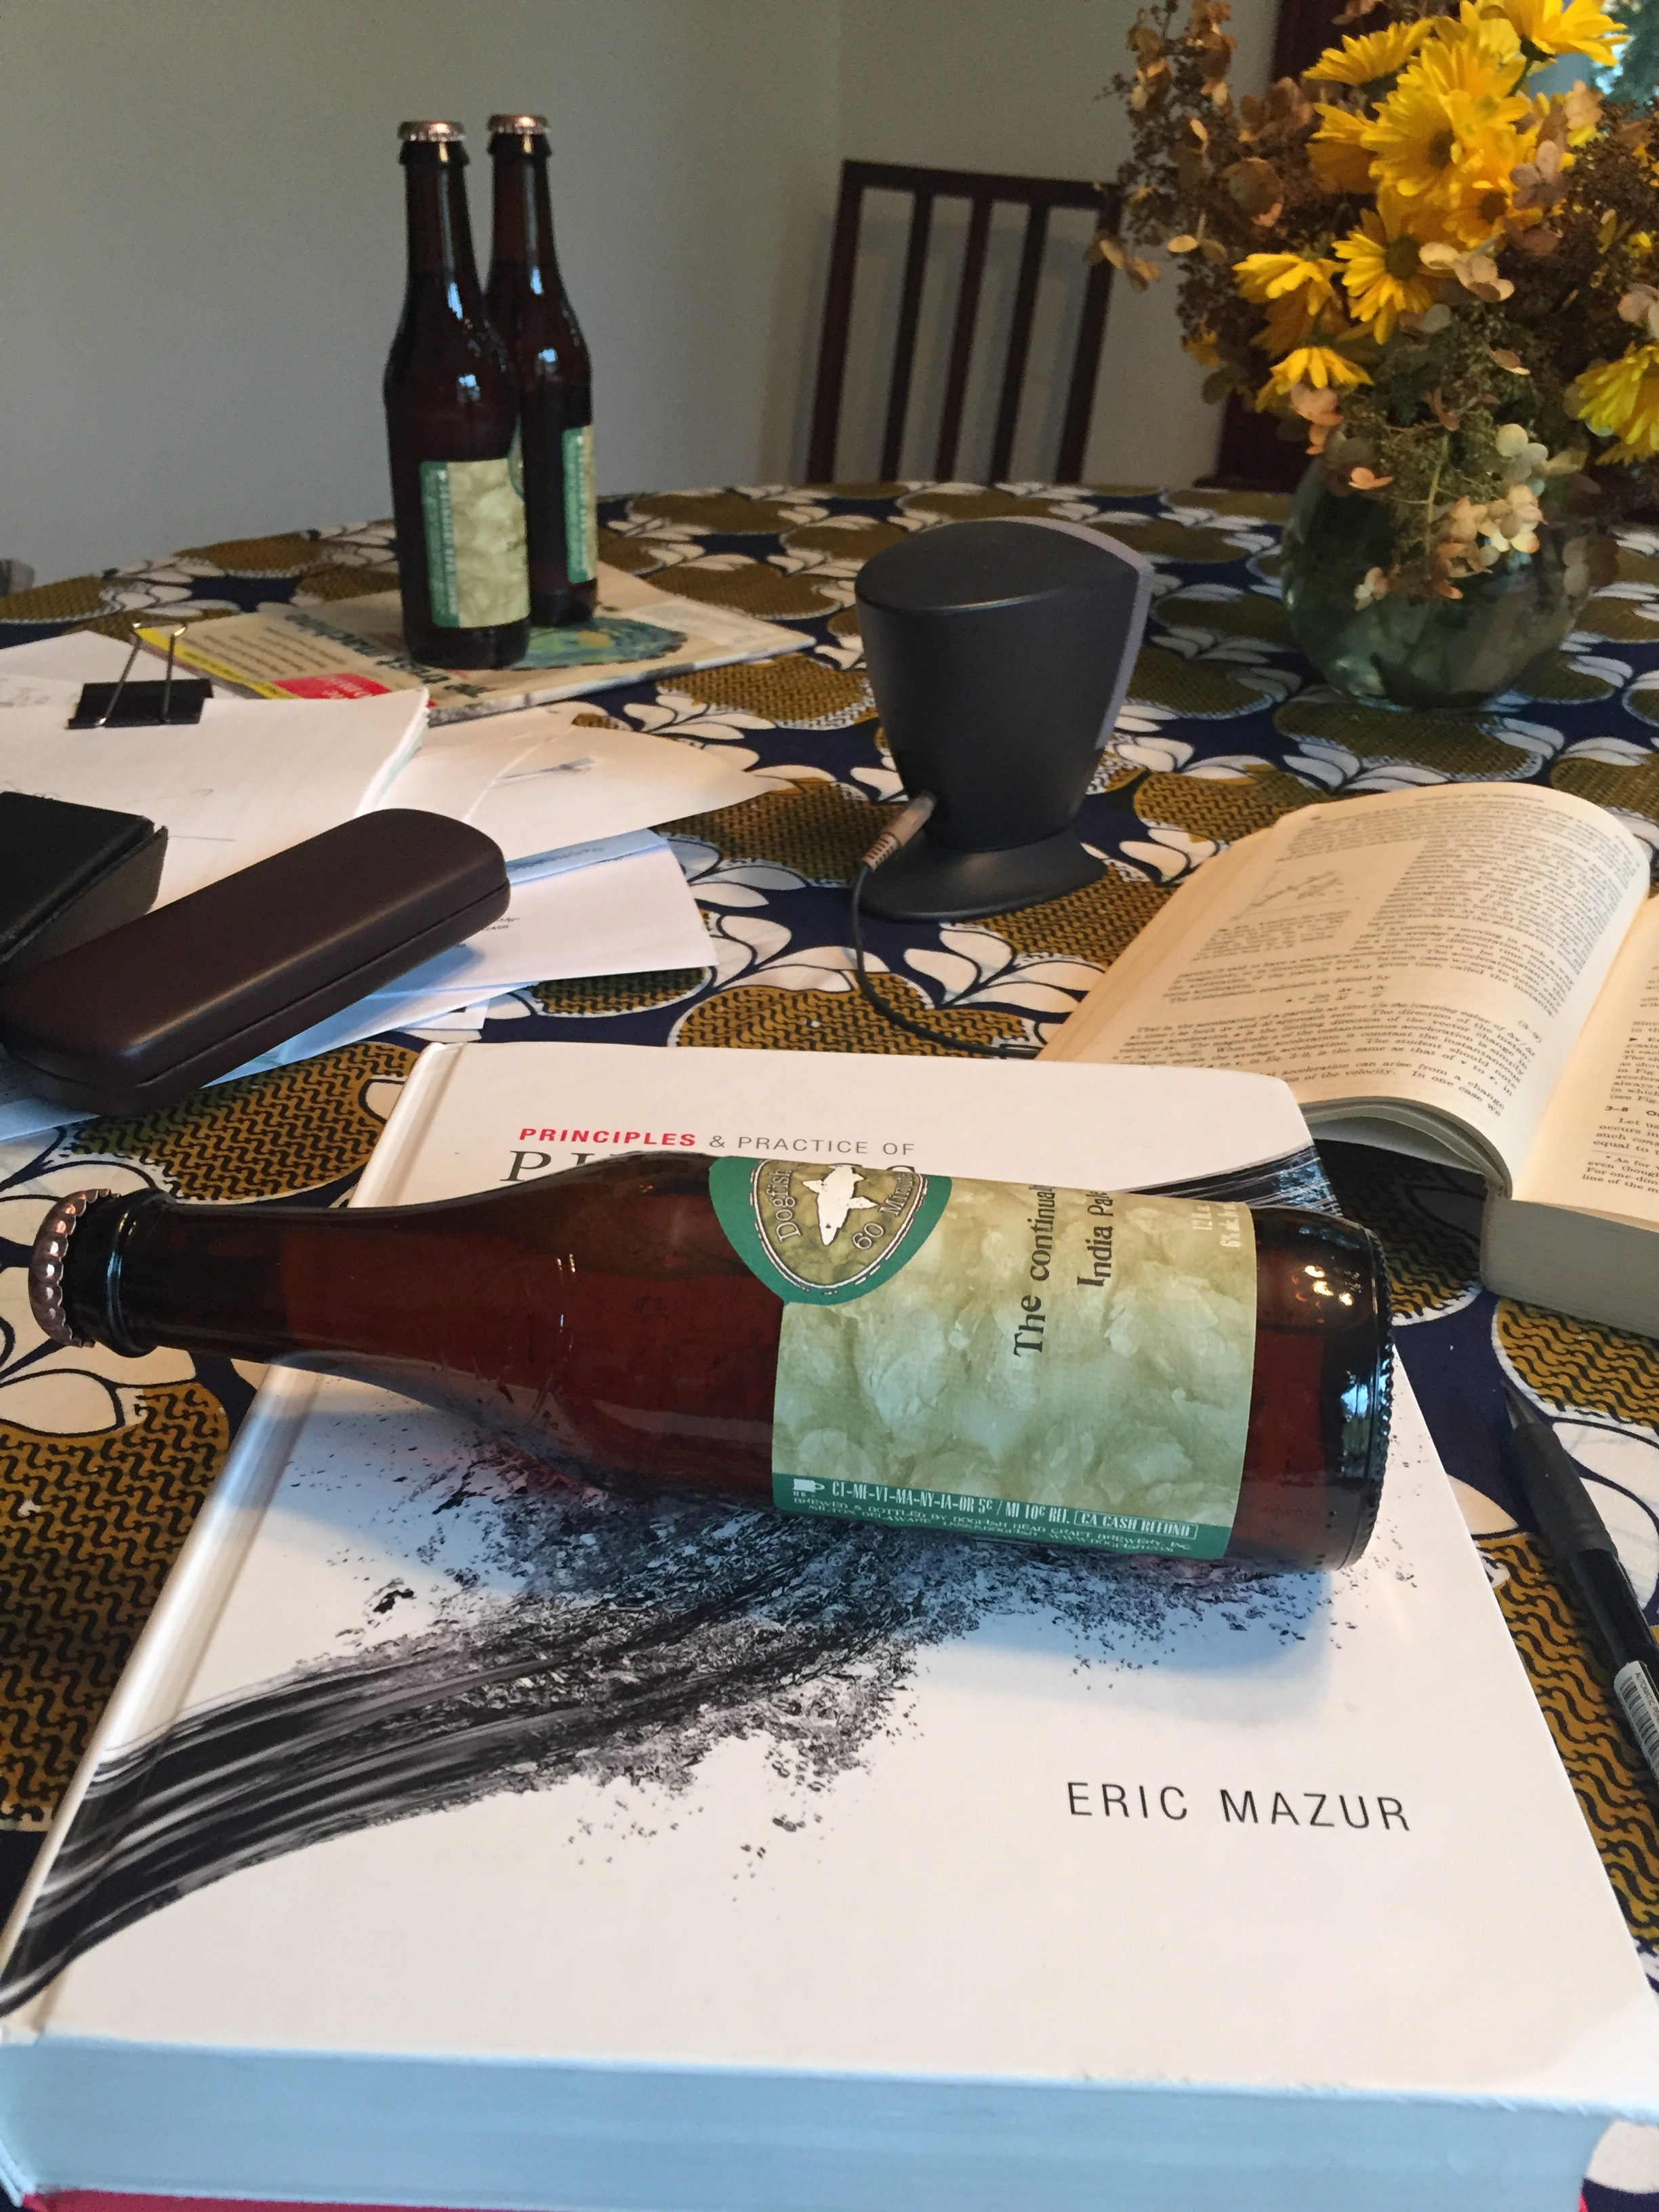

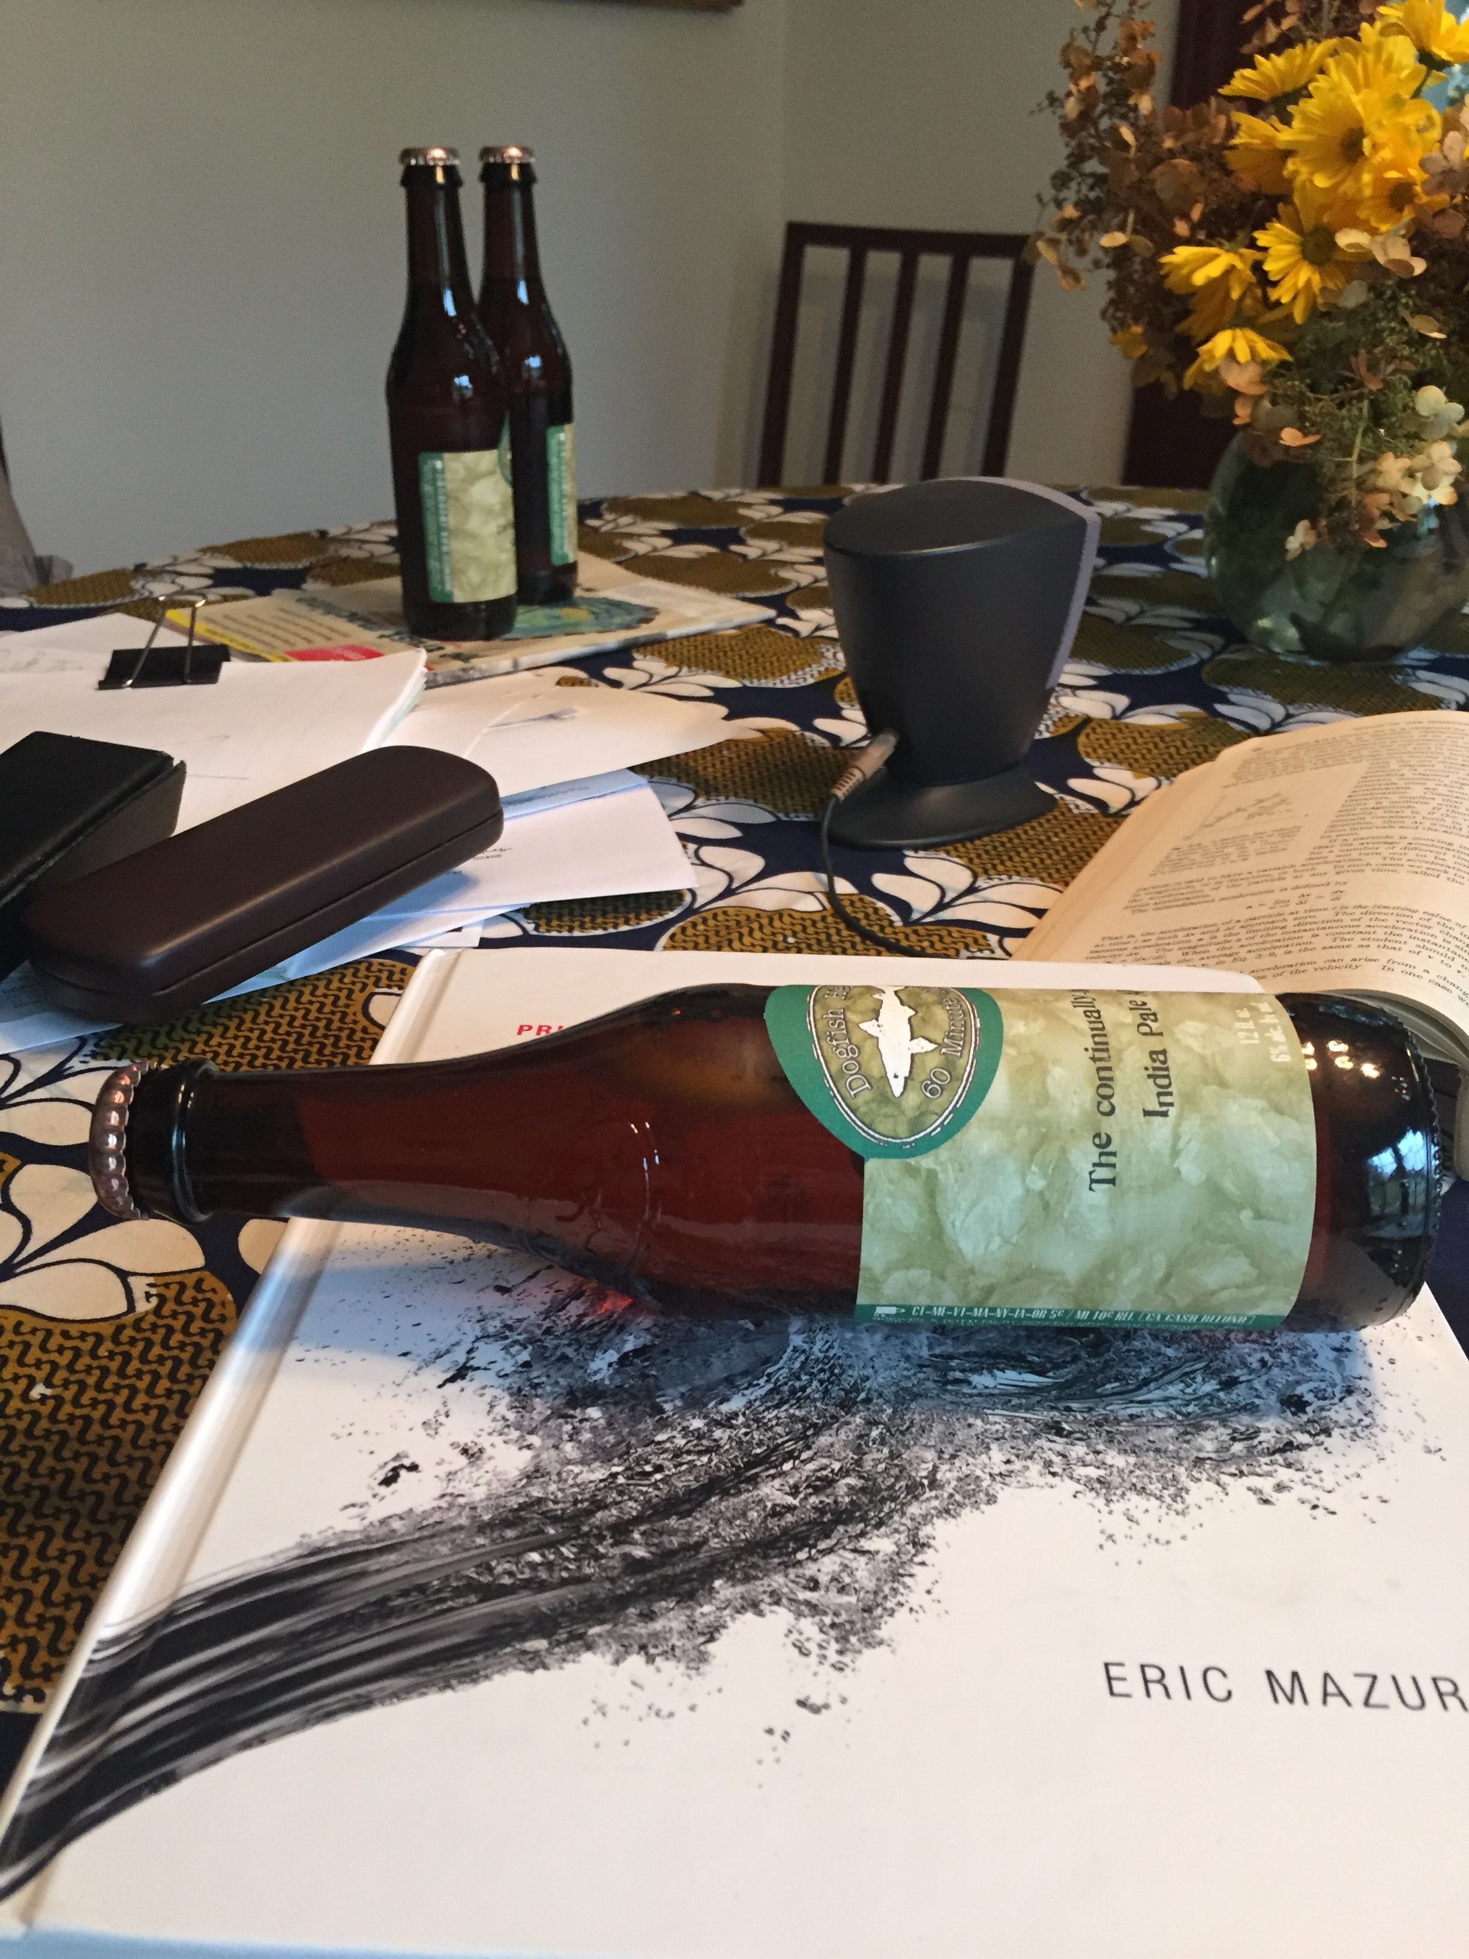

Section 12.4: The vector nature of rotation
Rotational displacements do not commute, however.
90 degrees around z axis
90 degrees around x axis
90 degrees around x axis
90 degrees around z axis
Slide 12-37

Slide 38
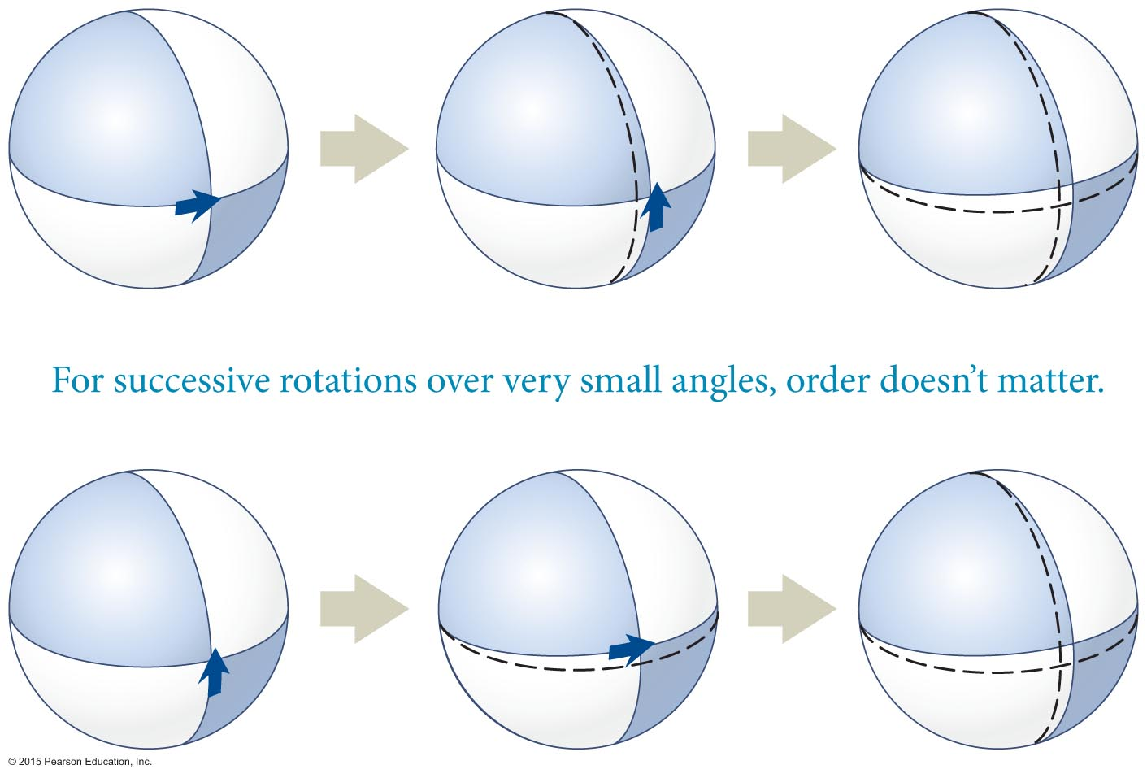
Section 12.4: The vector nature of rotation
Rotational displacements for small displacements do commute, however.
See how the orientation of the ball is same for the two different orders of rotation.
This implies that rotational velocity, ω = dθ/dt, does commute and can be associated with a vector using the right-hand rule.
Slide 12-38

Slide 39
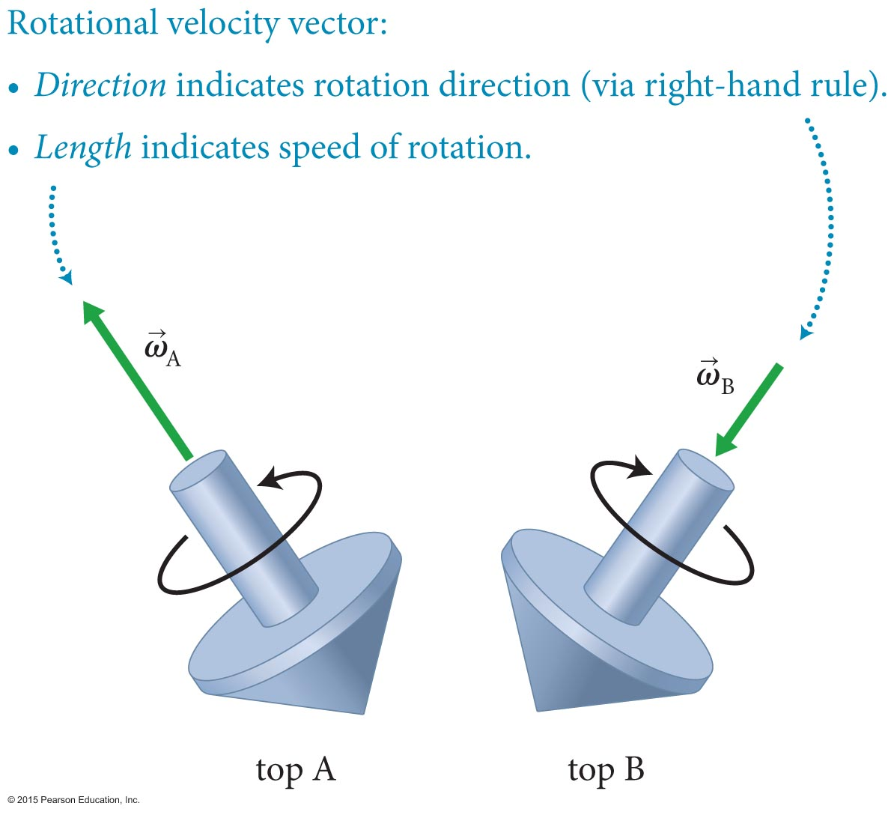
Section 12.4: The vector nature of rotation
The vector nature of rotational velocity is given by an axial vector defining the direction of rotation from the right-hand rule and a magnitude defining the speed of rotation.
Slide 12-39

Slide 40
Section Goals
Section 12.5: Conservation of angular momentum
You will learn to
Apply Newton’s Second Law for rotation to the rotational motion of extended objects.
Establish the conditions under which rotational angular momentum is conserved.
Slide 12-40

Slide 41
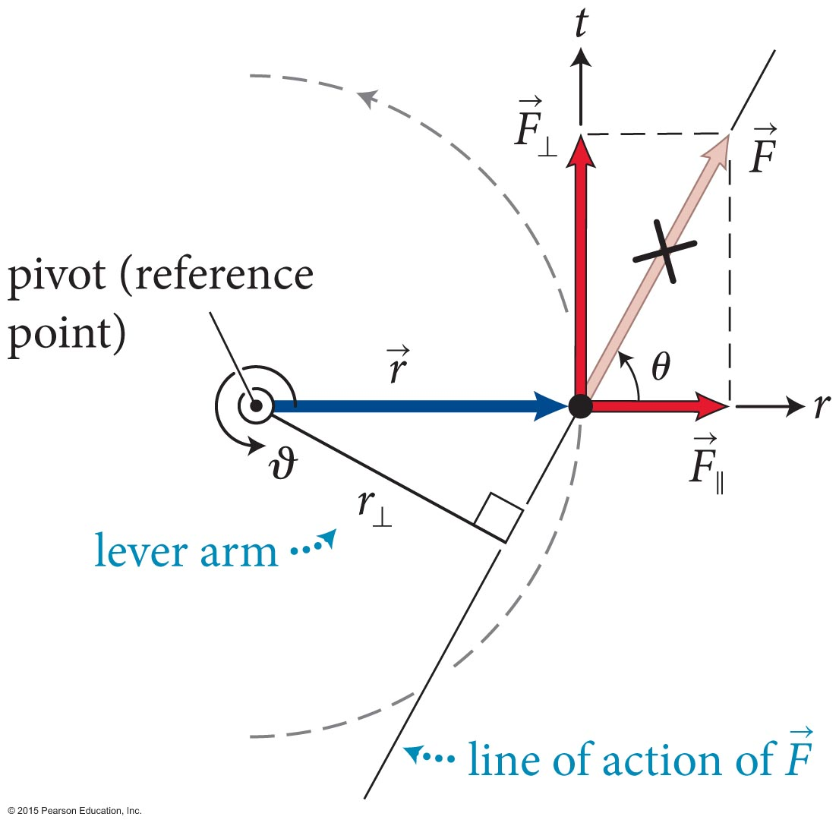
Section 12.5: Conservation of angular momentum
Consider the situation shown in the figure below: A force is exerted on a particle constrained to move in a circle.
The magnitude of the torque
caused by is:
τ ≡ rF sin θ = r⊥F = rF⊥
SI units of torque are N · m.
Slide 12-41

Slide 42
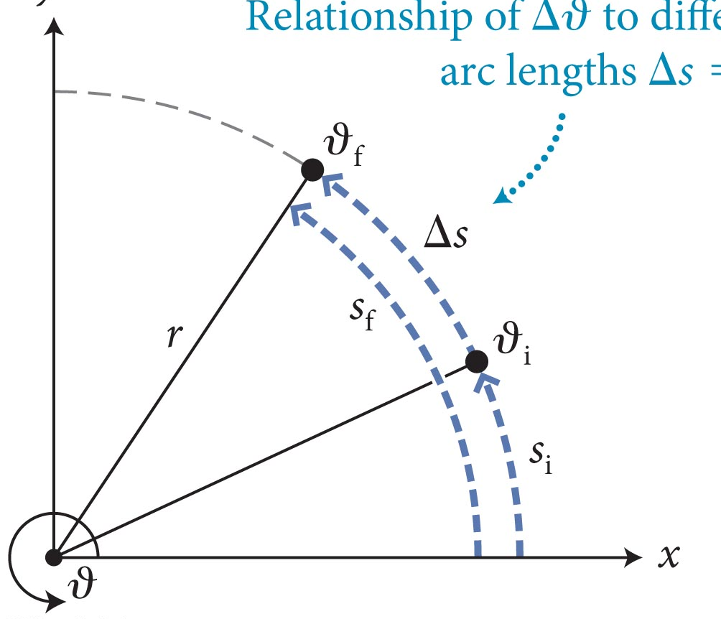
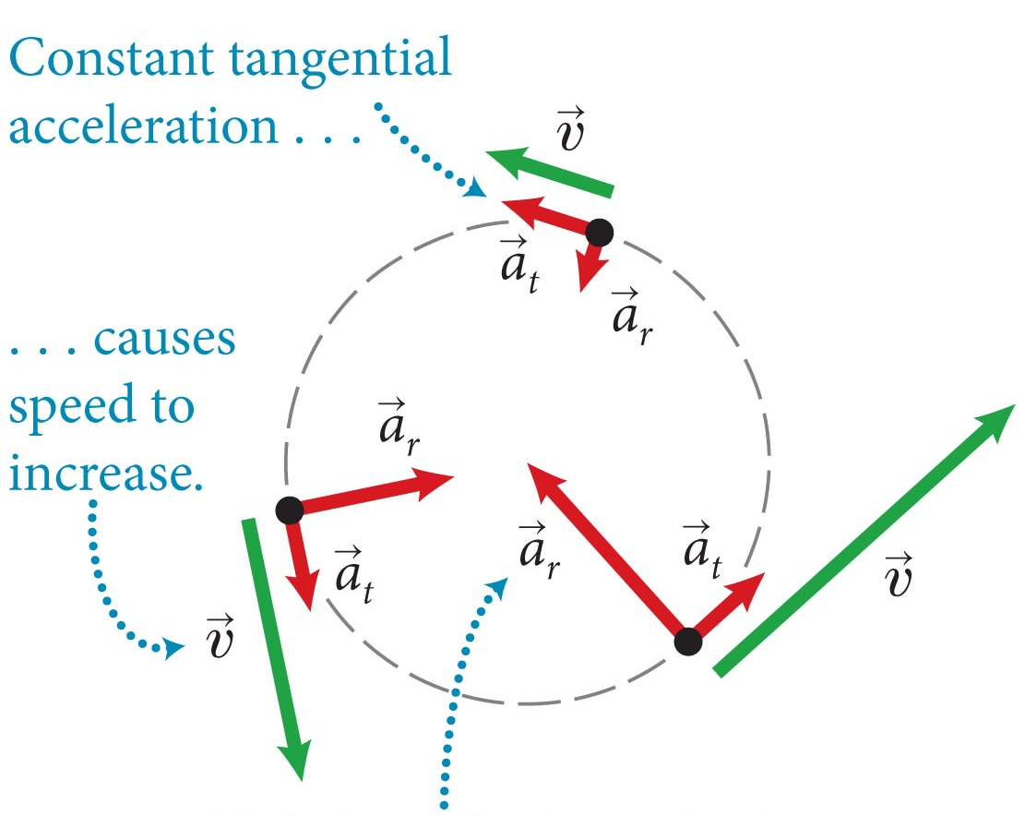
Section 12.5: Conservation of angular momentum
The tangential component of force F⊥ = |F_{t}| causes the particle to have a tangential acceleration (a_{t}) given by
F_{t} = ma_{t}
Combining equations 12.1 and 12.2 and using the relations s_{t} = rθ_{t} and v_{t} = rω_{t} and a_{t} = rα_{t} we obtain
τ_{ϑ} = rm(rα_{ϑ}) = mr² α_{ϑ}
where I = mr² is the rotational inertia of the particle
Slide 12-42

Slide 43
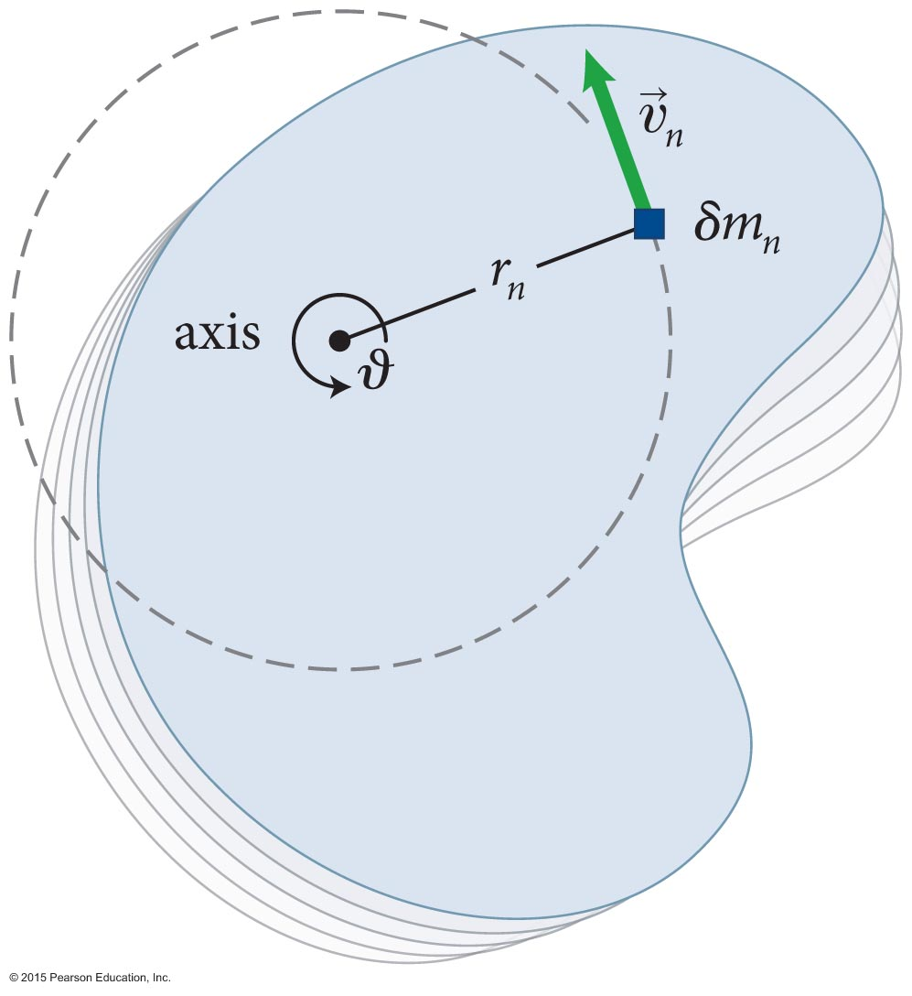
Section 12.5: Conservation of angular momentum
Now let us consider the case of an extended object.
Imagine breaking down the object into small particles of inertia δm_{n}, as shown in the figure.
Let each particle be subject to a torque τ_{nϑ}.
Using Eq. 12.4 we can write,
Slide 12-43

Slide 44
Chapter 12 Torque

Slide 45
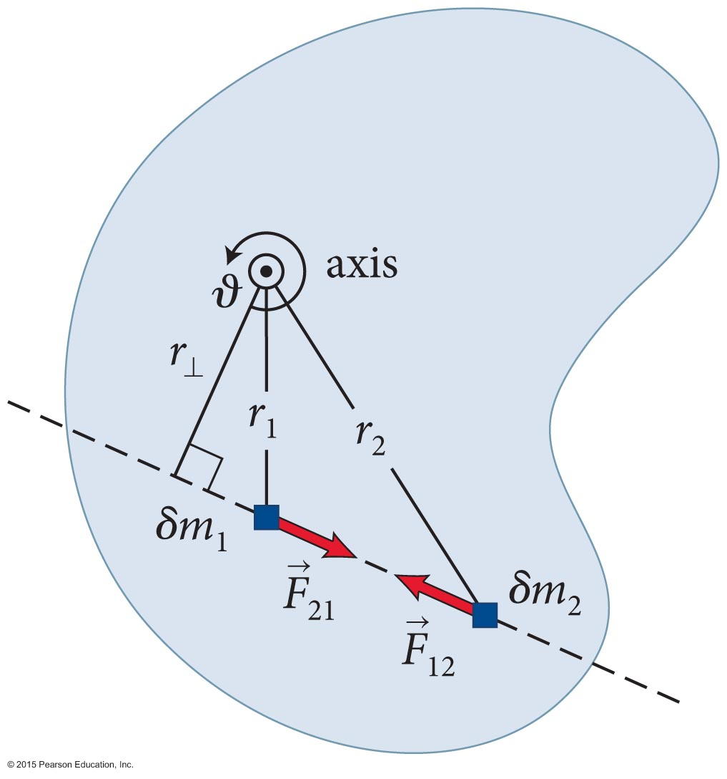
Section 12.5: Conservation of angular momentum
Then, the sum of the torques on
all particles can be written as
The sum on the left side of Eq. 12.7 contains torques due to external and internal forces.
But, the torques due to internal forces cancel out, giving us
Slide 12-45

Slide 46
Section 12.5: Conservation of angular momentum
Torque and angular momentum of an extended object.
Recall that angular momentum is given by L_{ϑ} = Iω_{ϑ} so
Therefore
Slide 12-46

Slide 47
Section 12.5: Conservation of angular momentum
If the sum of the torques caused by the external forces on a extended object is zero (isolated system), then
and the object is in rotational equilibrium.
An object in both translational and rotational equilibrium is said to be in mechanical equilibrium, and satisfies the conditions
Slide 12-47

Slide 48
Section 12.5: Conservation of angular momentum
For a system that is not in rotational equilibrium, we have the angular momentum law:
where J_{ϑ} represents the transfer of angular momentum from the environment.
J_{ϑ} is called the rotational impulse given by
Slide 12-48

Slide 49
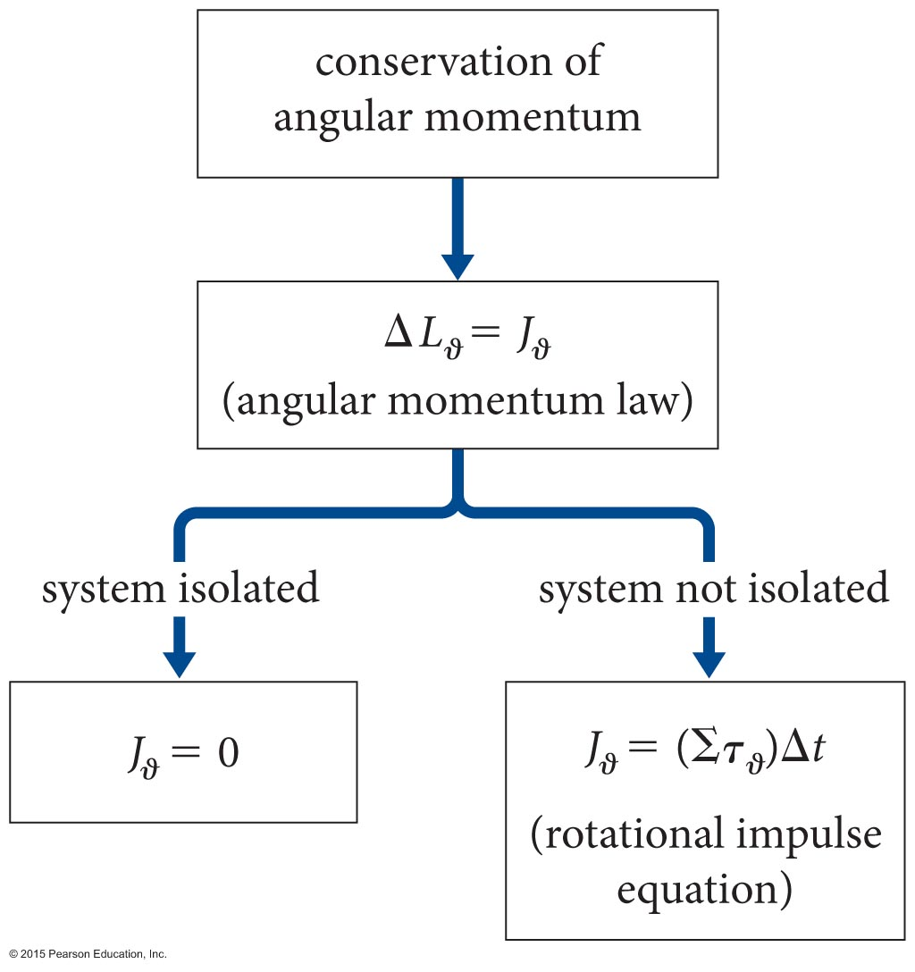
Section 12.5: Conservation of angular momentum
The figure below illustrates how conservation of angular momentum gives rise to the angular momentum law and how to treat isolated and nonisolated systems.
Slide 12-49

Slide 50

Section 12.6: Rolling motion
In one revolution, the advance of the wheel is .
For arbitrary rotations, ∆ϑ , the wheel advances ∆x_{cm} = R∆ϑ.
The relationship between the velocity of
the center-of-mass, ν_{cm}, and the rotational velocity, ω_{ϑ} , is
υ_{cm} = Rω_{ϑ} , for rolling motion without slipping.
Slide 12-50

Slide 51
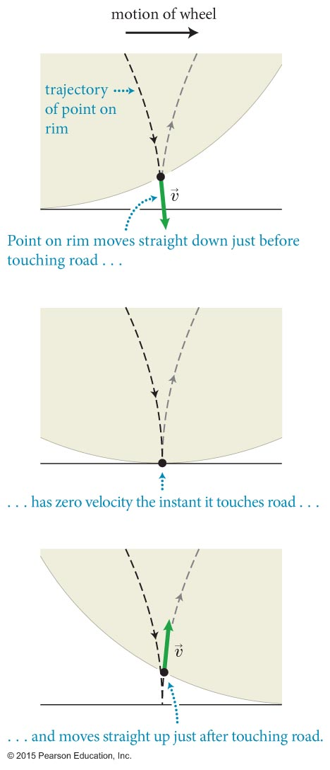

Section 12.6: Rolling motion
A point of the rim of a wheel that is in contact with the surface when rolling without slipping has zero instantaneous velocity.
Slide 12-51

Slide 52
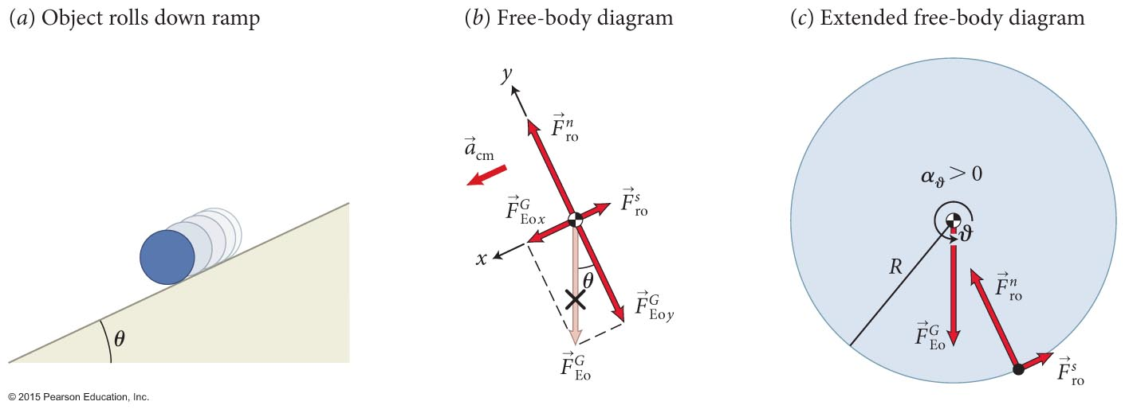
Section 12.6: Rolling motion
Consider an object rolling down a ramp without slipping.
Net force
Net torque
Slide 12-52

Slide 53
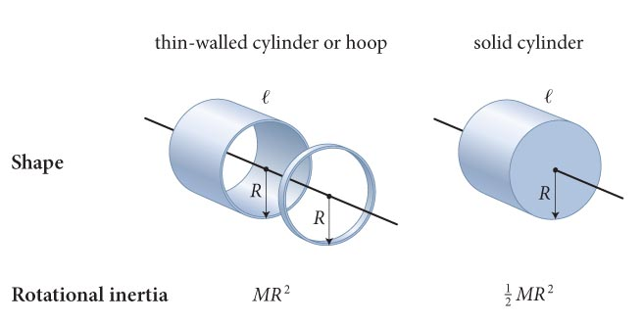
Section 12.6: Rolling motion
Net force
Net torque
disk (c = 0.5), ring (c = 1)
Slide 12-53

Slide 54
Section 12.6: Rolling motion
The static friction plays a dual role in this analysis:
  It decreases the center-of-mass speed and acceleration
  of the rolling object, and
  It causes the torque that gives the rotational acceleration.
Slide 12-54

Slide 55
Checkpoint 12.10
(a) A cylindrical shell and a solid cylinder, made of the same material and having the same inertia m and radius R, roll down a ramp. Is the force of static friction exerted on the shell greater than, smaller than, or equal to that on the solid cylinder?
12.10
Bigger c (I), Bigger friction
Slide 12-55

Slide 56
Checkpoint 12.10
(b) A cylindrical shell and a solid cylinder, made of the same material and having the same inertia m and radius R, roll down a ramp. For 𝜇_{s} = 1, what is the maximum angle of incline θ on which these objects can roll without slipping?
12.10
Bigger c (I), Smaller angle
Slide 12-56

Slide 57

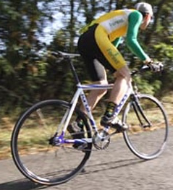

Example 12.7 Bicycle friction
Section 12.6: Rolling motion
As you accelerate from rest on a bicycle, how does the magnitude of the force of friction exerted by the road surface on the rear wheel compare with the magnitude of the force of friction exerted by the road surface on the front wheel? Ignore air resistance, assume both wheels have the same inertia m_{w}
and the same radius R, and let m_{comb} be the combined inertia of you and your bicycle (including both wheels).
Slide 12-57

Slide 58
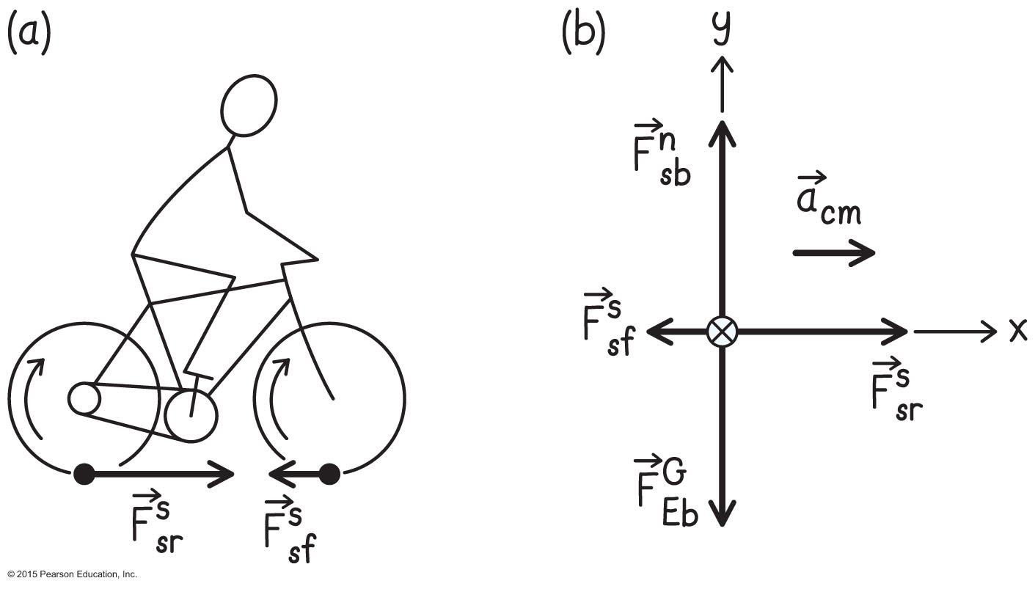
Example 12.7 Bicycle friction (cont.)
Section 12.6: Rolling motion
❶ GETTING STARTED Make a sketch of a bicycle (Figure 12.40a). As you push on the pedals, the chain causes a torque on the rear wheel that makes the wheel rotate so that it exerts a rearward force on the road surface. Consequently the road surface exerts on the rear wheel a contact force in the opposite direction, and the tangential component of this force—the force of static friction—is what makes the bicycle go forward.
Slide 12-58

Slide 59
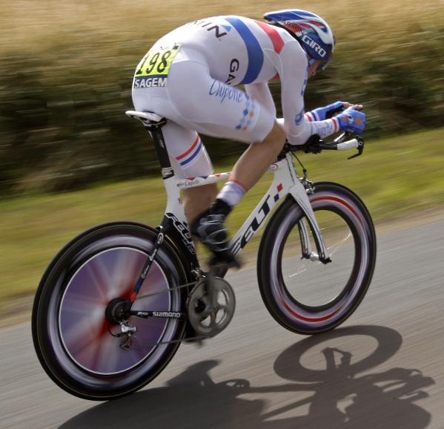

Example 12.7 Bicycle friction (cont.)
Section 12.6: Rolling motion
❶ GETTING STARTED The front wheel, because it is not connected to the chain, is merely pushed along with the rest of the bicycle. To make this wheel rotate in the right direction, the road surface must exert on it a rearward-pointing force of static friction (subscript f for “front” here). The torque caused by this frictional force is what makes the front wheel rotate, and this is the second force in my comparison.
Slide 12-59

Slide 60
Chapter 12 Torque

Slide 61
Example 12.7 Bicycle friction (cont.)
Section 12.6: Rolling motion
❸ EXECUTE PLAN The vector sum of the forces in the x direction is, from Eq. 8.45
so we have an expression that contains both of the forces we are after.
Torque balance:
This is the magnitude of the force of static friction required to make the front wheel roll when the bicycle has acceleration a_{cm} _{x}. The smaller the inertia of the wheel, the smaller this force magnitude.
Slide 12-61

Slide 62
Example 12.7 Bicycle friction (cont.)
Section 12.6: Rolling motion
❸ EXECUTE PLAN Turning to the other force, begin by eliminating a_{cm} _{x} from Eq. 1 using Eq. 2 to get
or
and
Because m_{comb} >> m_{w}, the magnitude of the force of static friction exerted on the front wheel is much smaller than that on the rear wheel,
Slide 12-62

Slide 63
Section 12.6: Rolling motion
(a) In Example 12.7, does the force of static friction exerted on the rear wheel cause a torque on the wheel? If so, in which direction? If not, why not? (b) In what direction is the sum of the torques on the rear wheel? What does this tell you about the relative magnitudes of the individual torques on the wheel?
12.11
(a) The surface force is perpendicular to the axel so causes a torque in the CCW direction.
(b) The wheel rotates CW, so the sum of the torques is CW.
(b) The torque from the pedals must be greater than the torque from the road.
Slide 12-63

Slide 64
Section 12.6
Clicker Question 7
A wheel rolls without slipping along a horizontal surface. The center of the wheel has a translational speed v. The lowermost point on the wheel has a forward velocity of magnitude
1. 2v.
2. v.
3. Zero.
4. We need more information.
Slide 12-64

Slide 65

Section 12.6
Clicker Question 7
A wheel rolls without slipping along a horizontal surface. The center of the wheel has a translational speed v. The lowermost point on the wheel has a forward velocity of magnitude
1. 2v.
2. v.
3. Zero.
4. We need more information.
Slide 12-65

Slide 66
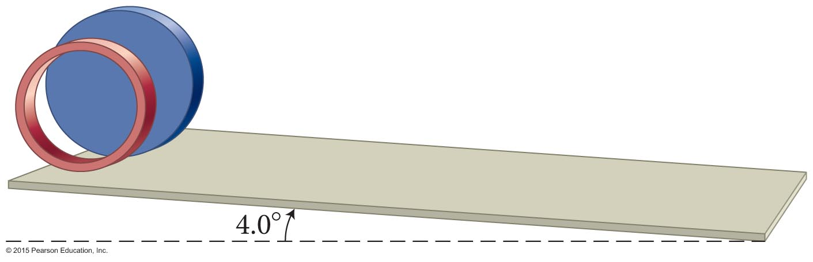
Section 12.7
Clicker Question 8
Two cylinders of the same size and mass roll down an incline. Cylinder A has most of its weight concentrated at the rim, while cylinder B has most of its weight concentrated at the center. Which reaches the bottom of the incline first?
  A
  B
  Both reach the bottom at the same time.
Slide 12-66

Slide 67
Section 12.7
Clicker Question 8
Two cylinders of the same size and mass roll down an incline. Cylinder A has most of its weight concentrated at the rim, while cylinder B has most of its weight concentrated at the center. Which reaches the bottom of the incline first?
  A
  B
  Both reach the bottom at the same time.
Slide 12-67
Notes:
Answer: 2. When the cylinders roll down the incline, gravitational potential energy gets converted to translational and rotational kinetic energy: mgh = 1⁄2 mv² + 1⁄2 Iω². We can substitute v/r for ω and write mgh = 1⁄2 (m + I/r²)v². The values for m and r are the same for both cylinders, and so the cylinder having the smaller rotational inertia has the larger speed. The smaller rotational inertia is obtained when more of the mass is concentrated near the center.

Slide 68
Section 12.7
Clicker Question 9
A solid disk and a ring roll down an incline. The ring is slower than the disk if
1. m_{ring}= m_{disk}, where m is the inertial mass.
2. r_{ring} = r_{disk}, where r is the radius.
3. m_{ring} = m_{disk} and r_{ring} = r_{disk}.
4. The ring is always slower regardless of the relative values of m and r.
Slide 12-68

Slide 69
Section 12.7
Clicker Question 9
A solid disk and a ring roll down an incline. The ring is slower than the disk if
1. m_{ring}= m_{disk}, where m is the inertial mass.
2. r_{ring} = r_{disk}, where r is the radius.
3. m_{ring} = m_{disk} and r_{ring} = r_{disk}.
4. The ring is always slower regardless of the relative values of m and r.
Slide 12-69
Notes:
Answer: 4. The ring has more rotational inertia per unit mass than the disk. Therefore as it starts rolling, it has a relatively larger fraction of its total kinetic energy in rotational form and so its translational kinetic energy is lower than that of the disk.
As the disk and ring roll down the incline, the potential energy of each is reduced by an amount mgh, where h is the difference in height between the bottom and top of the incline. This energy is converted to kinetic energy (translational and rotational): mgh = 1⁄2 mv2 + 1⁄2 Iω2. We can write the rotational inertia as I = cmR2, where c is a constant equal to 1 for the ring and 1⁄2 for the disk. Because ω = v/R, we have: mgh = 1⁄2mv2 + 1⁄2 cmR2(v/R)2 = 1⁄2 (1 + c)mv2.
The larger c, therefore, the smaller v. Thus the ring, which has the larger rotational inertia, takes longer to go down the incline, regardless of inertia and radius.

Slide 70
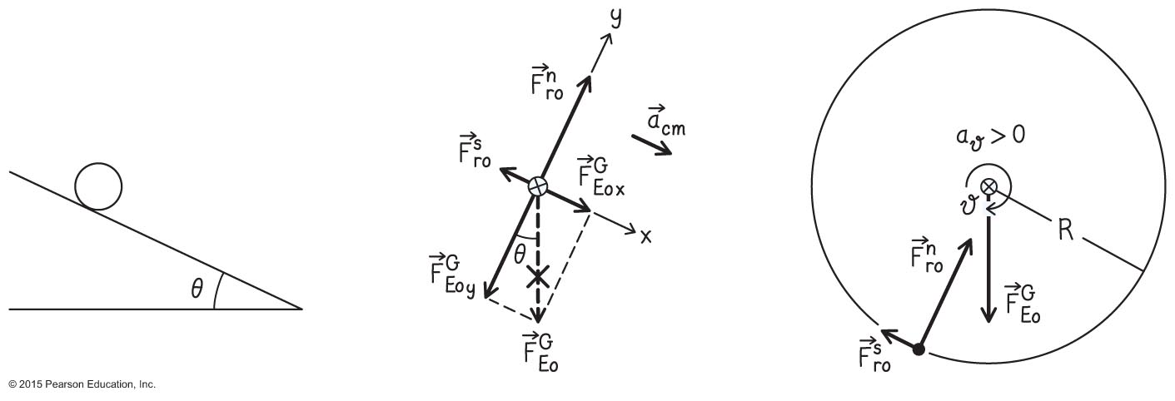
Example 12.8 Rolling down a ramp
Section 12.7: Torque and energy
A solid object of inertia m, rotational inertia I, and radius R rolls down a ramp that makes an angle θ with the horizontal. What is the acceleration of the object as a function of m, I, R and θ?
Slide 12-70

Slide 71
Section 12.6: Rolling motion
Net force
Net torque
ring (c = 1), disk (c = 0.5)
Slide 12-71

Slide 72
Section 12.7
Clicker Question 9
A solid disk and a ring roll down an incline. The ring is slower than the disk if
1. m_{ring}= m_{disk}, where m is the inertial mass.
2. r_{ring} = r_{disk}, where r is the radius.
3. m_{ring} = m_{disk} and r_{ring} = r_{disk}.
4. The ring is always slower regardless of the relative values of m and r.
Slide 12-72
Notes:
Answer: 4. The ring has more rotational inertia per unit mass than the disk. Therefore as it starts rolling, it has a relatively larger fraction of its total kinetic energy in rotational form and so its translational kinetic energy is lower than that of the disk.
As the disk and ring roll down the incline, the potential energy of each is reduced by an amount mgh, where h is the difference in height between the bottom and top of the incline. This energy is converted to kinetic energy (translational and rotational): mgh = 1⁄2 mv2 + 1⁄2 Iω2. We can write the rotational inertia as I = cmR2, where c is a constant equal to 1 for the ring and 1⁄2 for the disk. Because ω = v/R, we have: mgh = 1⁄2mv2 + 1⁄2 cmR2(v/R)2 = 1⁄2 (1 + c)mv2.
The larger c, therefore, the smaller v. Thus the ring, which has the larger rotational inertia, takes longer to go down the incline, regardless of inertia and radius.

Slide 73
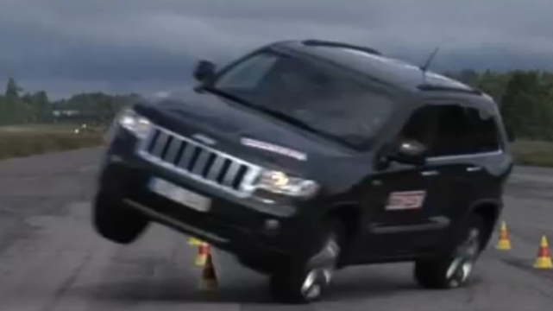
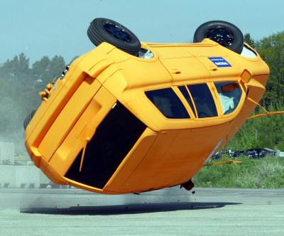
Rollover
https://www.youtube.com/watch?v=2IpCIYF0lVU
https://www.youtube.com/watch?v=N3_2_ghFx6w
https://www.youtube.com/watch?v=jv0MJmj65T8
10:57, 14:45
https://www.youtube.com/watch?v=7Anbn3OYZ0I
Slide 12-73

Slide 74
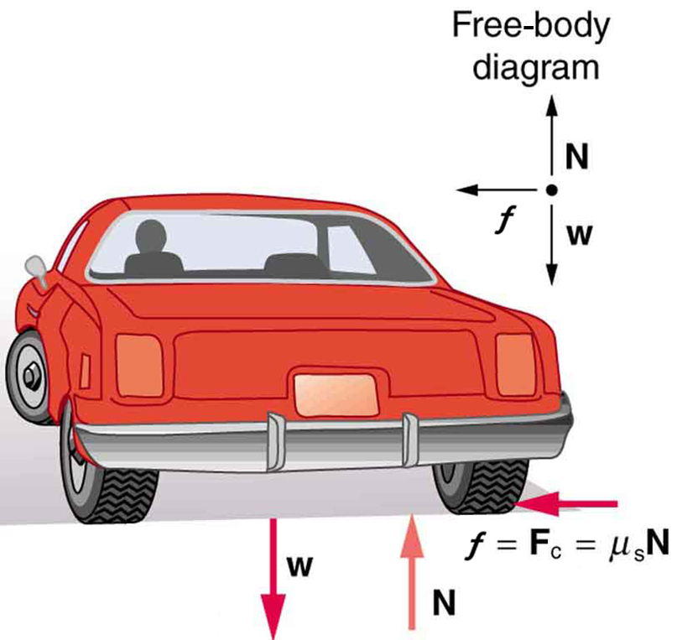
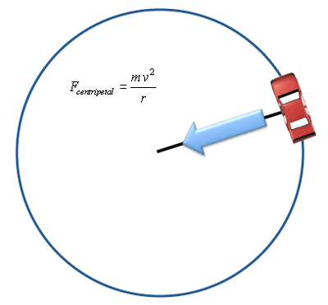
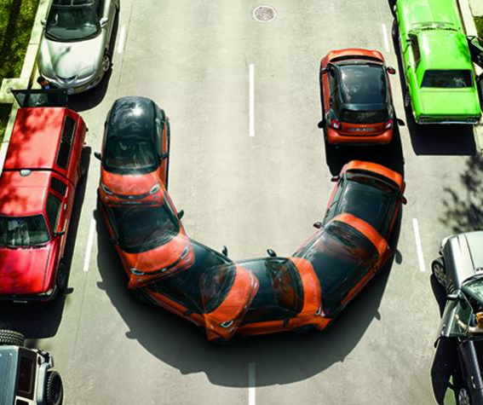
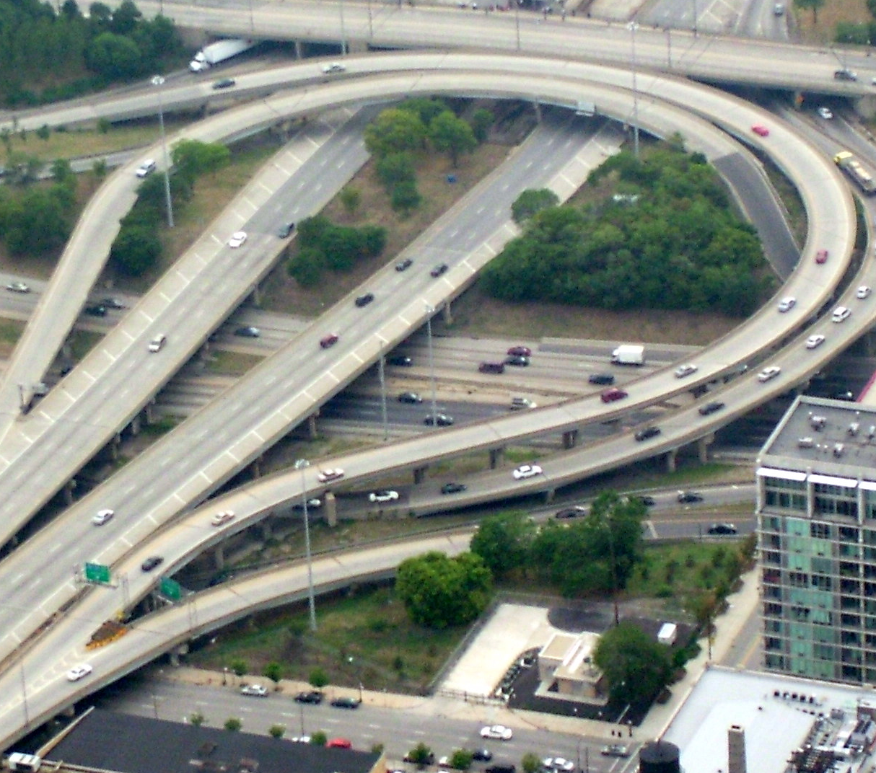
Rollover
Left turn.
Slide 12-74

Slide 75
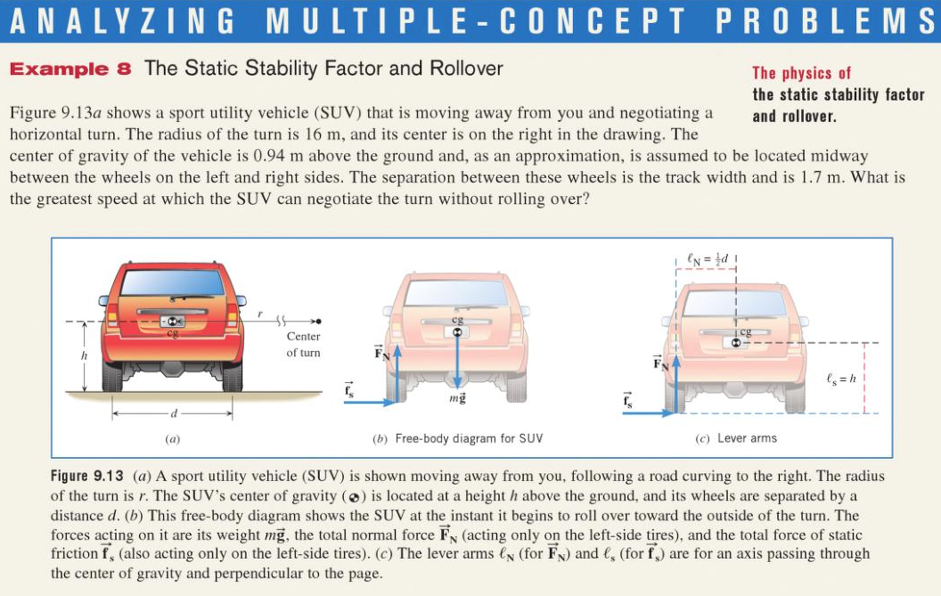
Rollover
Right turn.
Slide 12-75

Slide 76
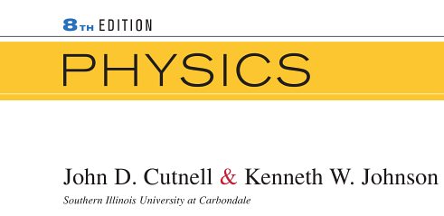
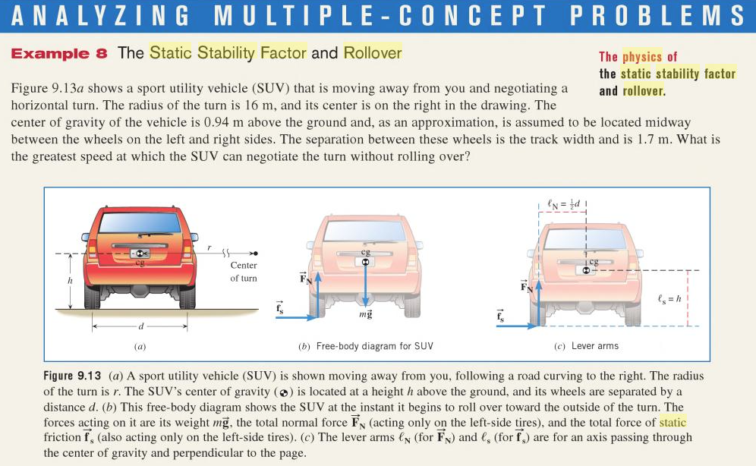
Rollover
Right turn.
mg
and
h
d
Calculate torque about CM when inner wheel just lifts off ground.
Warning: CM is special choice! Choosing wheel doesn’t work.
Rollover for higher speeds
Skid?
Skid for higher speeds
Skid or flip?
flip!
Slide 12-76
Notes:
See discussion on https://www.physicsforums.com/threads/torque-in-a-non-inertial-reference-frame.590315/

Slide 77
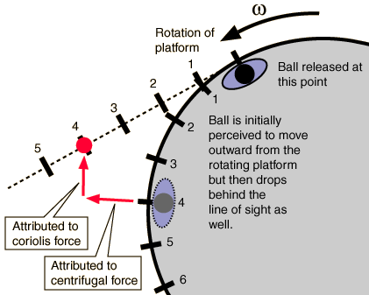
Rollover
https://www.youtube.com/watch?v=_36MiCUS1ro
https://www.youtube.com/watch?v=dt_XJp77-mk
Right turn.
mg
and
h
d
Calculate torque about CM when inner wheel just lifts off ground.
Warning: CM is special choice! Choosing wheel doesn’t work.
Rollover for higher speeds
Skid?
Skid for higher speeds
Skid or flip?
flip!
Slide 12-77
Notes:
See discussion on https://www.physicsforums.com/threads/torque-in-a-non-inertial-reference-frame.590315/

Slide 78
Rollover
Right turn.
Rollover for higher speeds
Skid for higher speeds
h
d
Static Stability Factor.
SSF > μ
so skid instead of roll!
SSF = 1.0 for SUV.
SSF = 1.5 for sedan.
dry road μ = 0.7, wet road, μ = 0.4
Slide 12-78

Slide 79
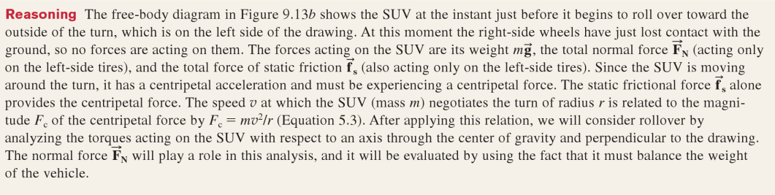
Rollover
Slide 12-79

Slide 80


Section 12.8
Clicker Question 10
A person spins a tennis ball on a string in a horizontal circle (so that the axis of rotation is vertical). At the point indicated below, the ball is given a sharp blow in the forward direction. This causes a change in angular momentum in the
1. x direction.
2. y direction.
3. z direction.
Slide 12-80

Slide 81
Section 12.8
Clicker Question 10
A person spins a tennis ball on a string in a horizontal circle (so that the axis of rotation is vertical). At the point indicated below, the ball is given a sharp blow in the forward direction. This causes a change in angular momentum in the
1. x direction.
2. y direction.
3. z direction.
Slide 12-81
Notes:
Answer: 3. The force F makes the ball go around the circle faster than before, and so the ball’s angular momentum increases in magnitude without changing direction. According to the right-hand rule, the angular velocity is in the +z direction, and so the change in angular momentum must also be in the +z direction.

Slide 82

Section 12.8
Clicker Question 11
A person spins a tennis ball on a string in a horizontal circle (so that the axis of rotation is vertical). At the point indicated below, the ball is given a sharp blow vertically downward. In which direction does the axis of rotation tilt towards after the blow?
  +x direction
  –x direction
  +y direction
  –y direction
  It stays the same (but the magnitude
  of the angular momentum changes).
  The ball starts wobbling in all
  directions.
Slide 12-82

Slide 83
Section 12.8
Clicker Question 11
A person spins a tennis ball on a string in a horizontal circle (so that the axis of rotation is vertical). At the point indicated below, the ball is given a sharp blow vertically downward. In which direction does the axis of rotation tilt towards after the blow?
  +x direction
  –x direction
  +y direction
  –y direction
  It stays the same (but the magnitude
  of the angular momentum changes).
  The ball starts wobbling in all
  directions.
Slide 12-83
Notes:
Answer: 1. As it receives the blow, the ball accelerates downward and its velocity gains a downward component. Still constrained by the string to go around in a circle, the ball moves in a new circular path the plane of which is determined by the instantaneous velocity v the ball has immediately after the blow. This velocity v′ defines a plane that is tilted downward in the forward direction (+x direction). The angular momentum therefore also tilts forward in the +x direction. The change in angular momentum is the dashed vector connecting L and L′.
Explanation using torque: According to the right-hand rule, the torque exerted by the force is in the forward direction (+x), and so the change in angular momentum must also be in this direction.

Slide 84

Section 12.7: Torque and energy
Torques causes objects to accelerate rotationally and thus cause a change in their rotational kinetic energy.
Consider the object in the figure. A force is exerted at point P on the object. Using Eq. 12.10 we can write
Integrating both sides:
Slide 12-84

Slide 85
Section 12.7: Torque and energy
Now, if the object is in both translational and rotational motion, then its kinetic energy is given by
And the change in kinetic energy is given by
∆K = ∆K_{cm} + ∆K_{rot}
Slide 12-85

Slide 86
Section Goals
Section 12.8: The vector product
You will learn to
Use a generalization of the concept of multiplication to calculate how to combine two vectors into a third vector using the operation of the vector product.
Visualize the vector nature of torque and angular momentum using the vector product.
Interpret the significance and application of some mathematical identities concerning the vector product.
Slide 12-86

Slide 87

Section 12.8: The vector product
This figure shows that the rotational velocity, rotational acceleration, and torque vectors all point along the rotational axis.
Slide 12-87

Slide 88

Section 12.8: The vector product
This figure shows geometry of the vector product between two vectors and . The vector product is a mathematical operation that combines two vectors to obtain a third vector.
Slide 12-88

Slide 89
Section 12.8: The vector product (cont.)
The magnitude of the resultant of the vector product is given by the expression
This magnitude is the area of the parallelogram formed by the vectors and .
Slide 12-89

Slide 90
Section 12.8: The vector product
The direction of the resultant of the vector product is in a direction perpendicular to the vectors and .
Slide 12-90

Slide 91

Section 12.8: The vector product
The relationships between translational dynamics and rotational dynamics is shown in this table.
Slide 12-91

Slide 92
Concepts: Torque
Chapter 12: Summary
Torque is due to the tendency of a force applied to an object to give a rotational acceleration.
The SI units for torque are N • m.
Rotational equilibrium requires the vector sum of the net external torque on an object equal zero.
Mechanical equilibrium requires in addition that the vector sum of the net external force equal zero.
Slide 12-92

Slide 93
Quantitative Tools: Torque
Chapter 12: Summary
If is the position vector from a pivot to the location at which a force is exerted on an object and θ is the angle between and , the torque τ produced by the force about the pivot is
where is the component of perpendicular to and
is the component of perpendicular to .
Slide 12-93

Slide 94
Quantitative Tools: Torque
Chapter 12: Summary
Translational equilibrium:
Rotational equilibrium:
Mechanical equilibrium:
Slide 12-94

Slide 95
Concepts: Rotation of a rigid object
Chapter 12: Summary
In free rotation an object rotates about its center of mass.
In rotation about a fixed axis an object is constrained to rotate about a physical axis.
In rolling motion without slipping there is no relative motion at the location where the object touches the surface.
The external force on a rolling object changes the object’s center-of-mass kinetic energy.
The external torque on a rolling object changes its rotational kinetic energy.
Slide 12-95

Slide 96
Quantitative Tools: Rotation of a rigid object
Chapter 12: Summary
For both particles and extended bodies, the vector sum of the torques when rotation is about a fixed axis is
For an object of radius R that is rolling without slipping, the motion of the center of mass is described by
Slide 12-96

Slide 97
Quantitative Tools: Rotation of a rigid object
Chapter 12: Summary
The change in an object’s rotational kinetic energy resulting from torques is
The kinetic energy of a rolling object is
The change in the kinetic energy of a rolling object is
Slide 12-97

Slide 98
Concepts: Angular momentum
Chapter 12: Summary
A rotational impulse J_{ϑ} is the amount of angular momentum transferred to a system from the environment by external torques.
If the sum of the external torques due to forces exerted on a system is zero, the angular momentum of the system remains constant.
Slide 12-98

Slide 99
Quantitative Tools: Angular momentum
Chapter 12: Summary
External torque caused by forces exerted on an object causes the object’s angular momentum L_{ϑ} to change:
Slide 12-99

Slide 100
Quantitative Tools: Angular momentum
Chapter 12: Summary
The angular momentum law says that the change in the angular momentum of an object is equal to the rotational impulse given to the system:
If the constant external torques on a system last for a time interval Δt, the rotational impulse equation says that the rotational impulse is
The law of conservation of angular momentum states that if
then dL_{ϑ} /dt = 0. This means that
Slide 12-100

Slide 101
Concepts: Rotational quantities as vectors
Chapter 12: Summary
A polar vector is a vector associated with a displacement.
An axial vector is a vector associated with a rotation direction. This vector points along the rotation axis.
The right-hand rule for axial vectors: When you curl the fingers of your right hand along the direction of rotation, your outstretched thumb points in the direction of the vector that specifies that rotation.
Slide 12-101

Slide 102
Concepts: Rotational quantities as vectors
Chapter 12: Summary
Right-hand rule for vector products: When you align the fingers of your right hand along the first vector in a vector product and curl them from that vector to the second vector in the product through the smaller angle between the vectors, your outstretched thumb points in the direction of the vector product.
The magnitude of the vector product of two vectors is equal to the area of the parallelogram defined by them.
Slide 12-102

Slide 103
Quantitative Tools: Rotational quantities as vectors
Chapter 12: Summary
The magnitude of the vector product of vectors and that make an angle θ ≤ 180° between them when they are tail to tail is
If is the vector from the origin of a coordinate system to the location where a force is exerted, the torque about the origin due to is
If is the vector from the origin of a coordinate system to a particle that has momentum , the angular momentum of the particle about the origin is
Slide 12-103

